Slide 1
National Schools Twenty20 competition
Finals day July 2013
Arundel Castle

Slide 2
Photographs
by
Patrick Eagar
© No images may be reproduced without permission

Slide 3
The first semi-final
King’s Taunton in blue
Shrewsbury in yellow

Slide 4
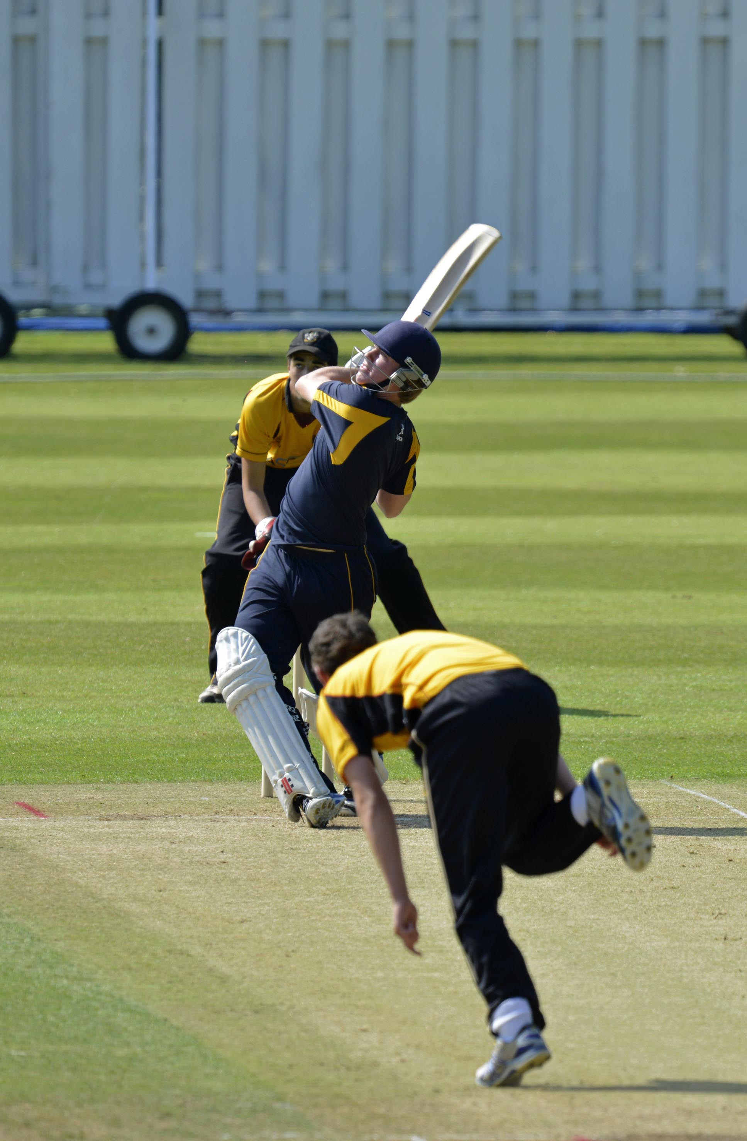
Edward Pollock hits out during his 92, semi-final Bolton v Shrewsbury,

Slide 5
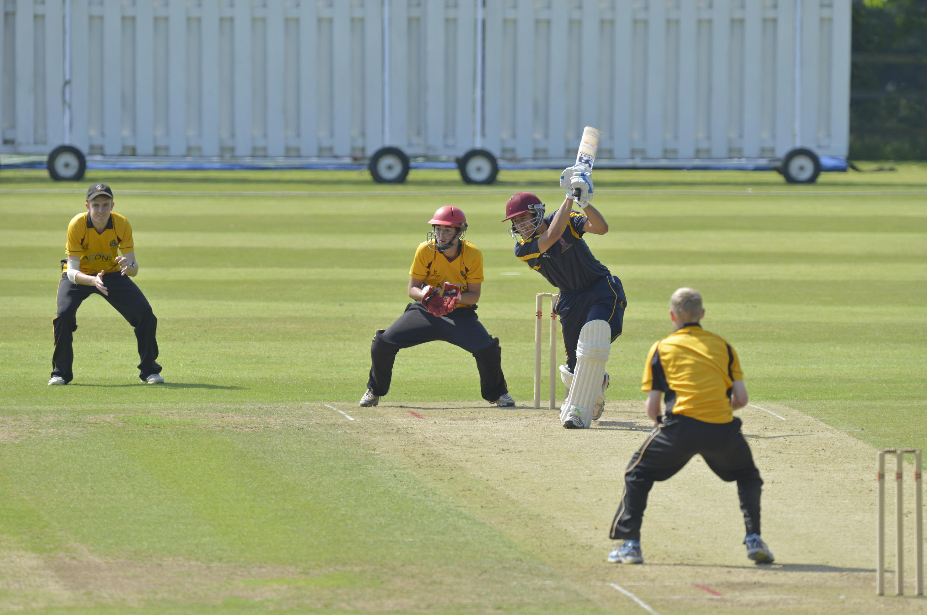
Joe Carrasco drives Callum Parkinson during his 68 in the semi-final Bolton v Shrewsbury

Slide 6
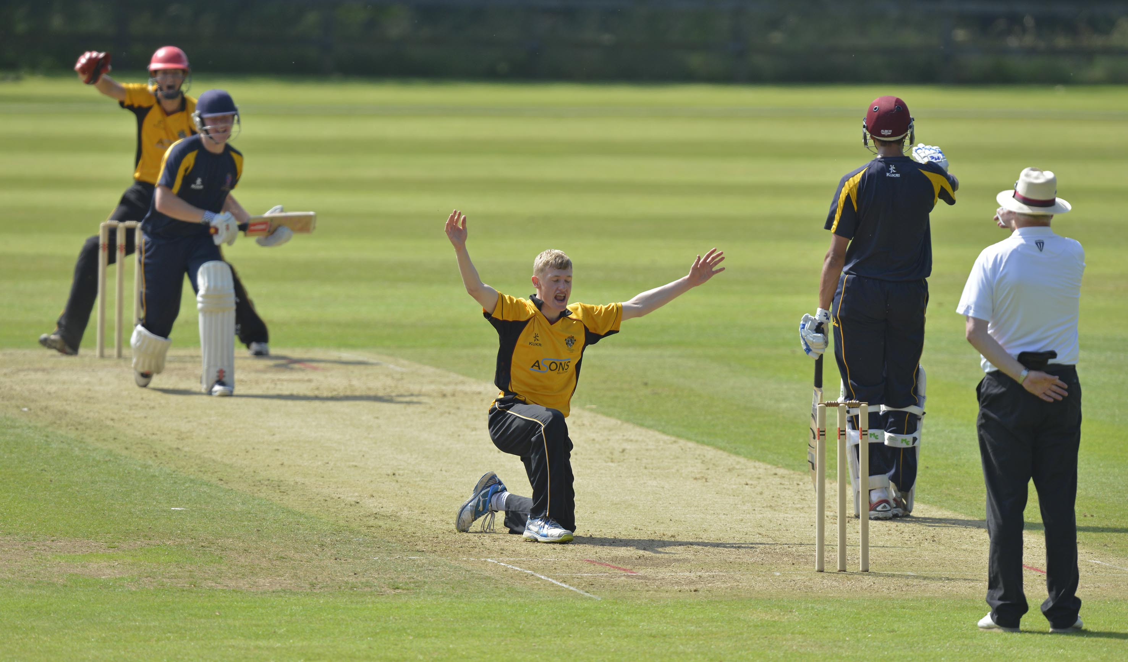
Callum Parkinson (Bolton) gets Edward Pollock out lbw for 92 in the semi-final Bolton v Shrewsbury

Slide 7
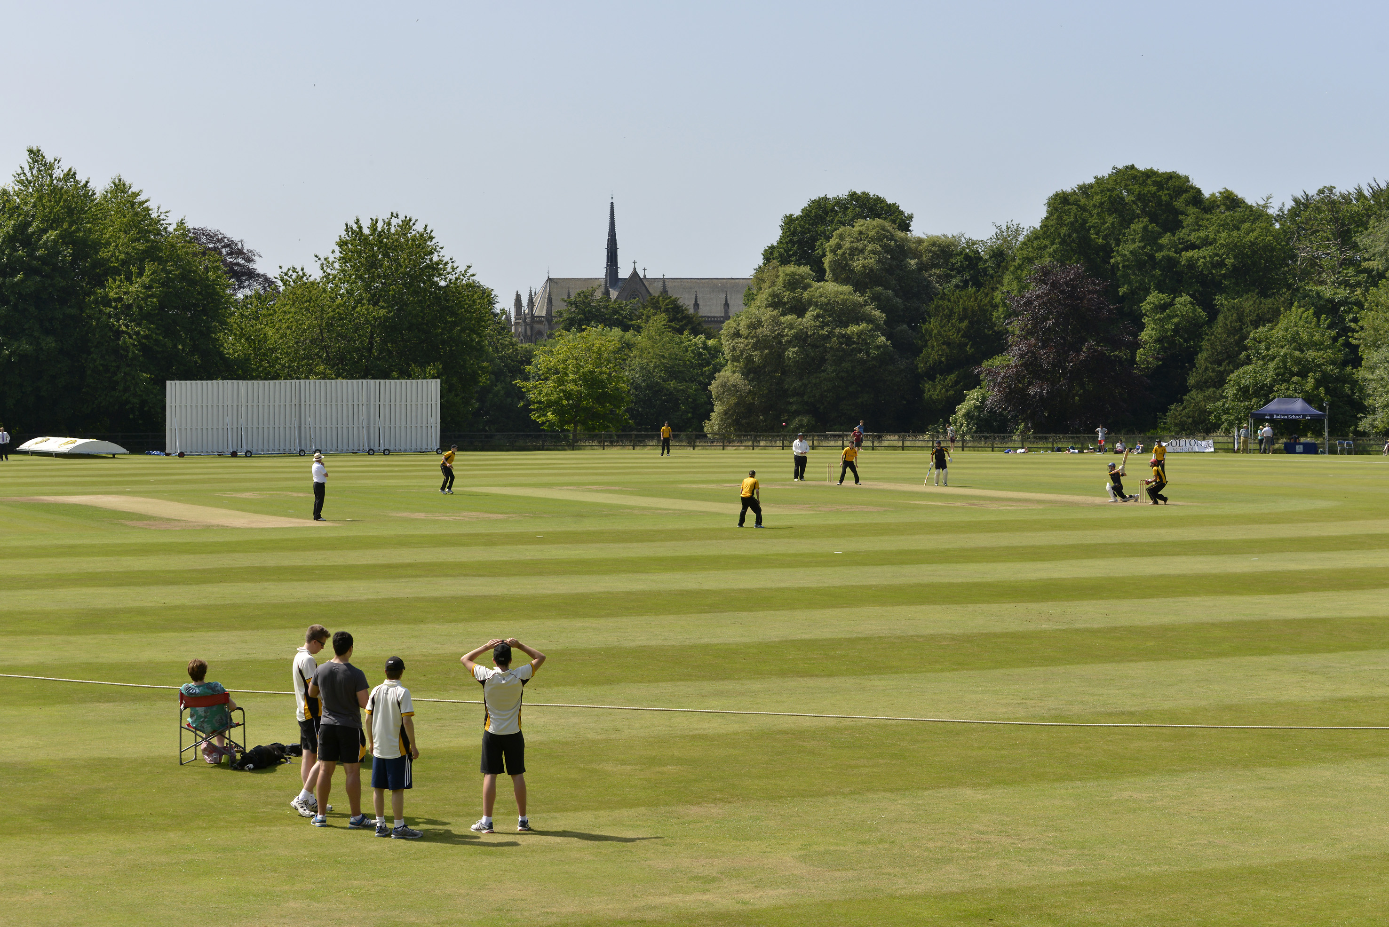
Semi-final Bolton v Shrewsbury

Slide 8
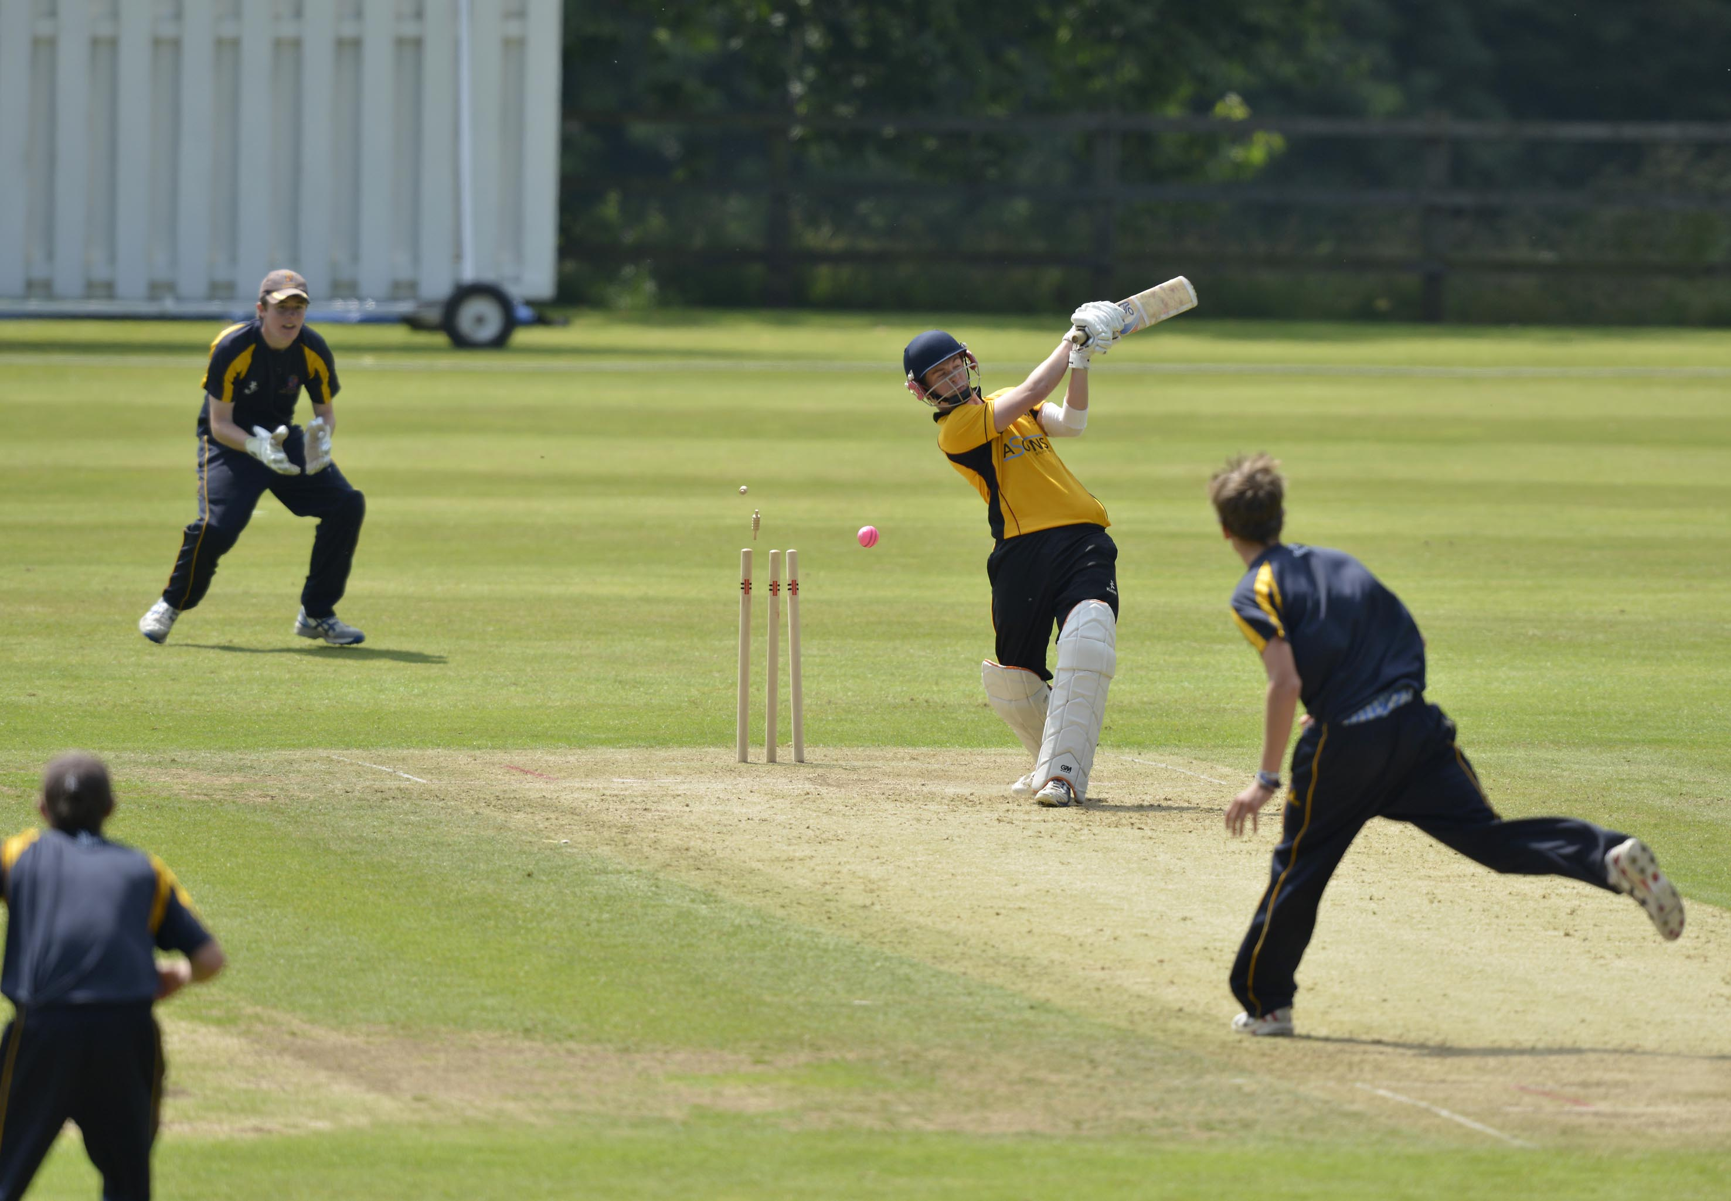
Sam Towers (Bolton) bowled by Charlie White for 2; semi-final Bolton v Shrewsbury,

Slide 9
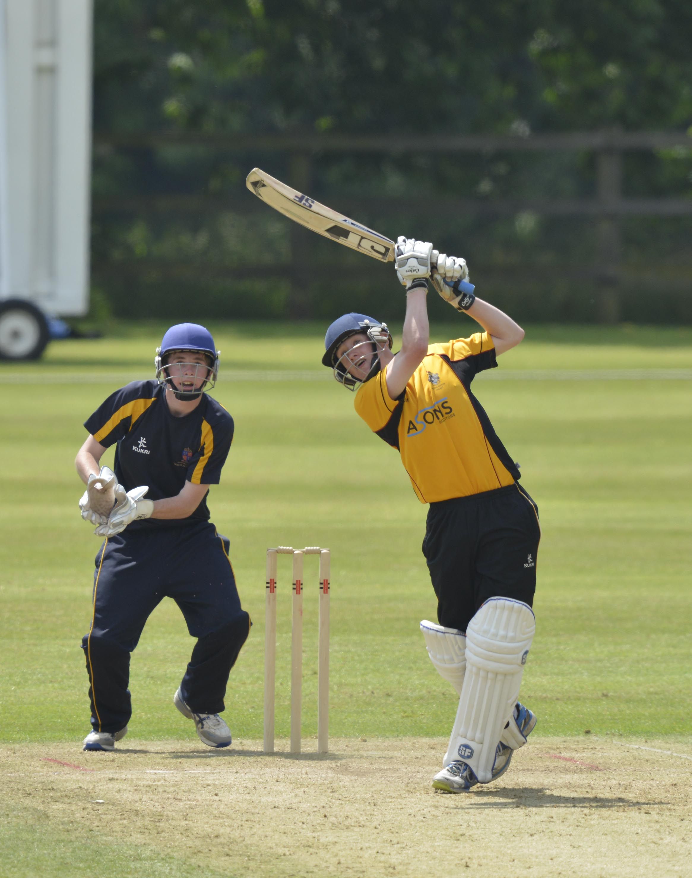
Callum Parkinson (Bolton) drives in the semi-final Bolton v Shrewsbury

Slide 10
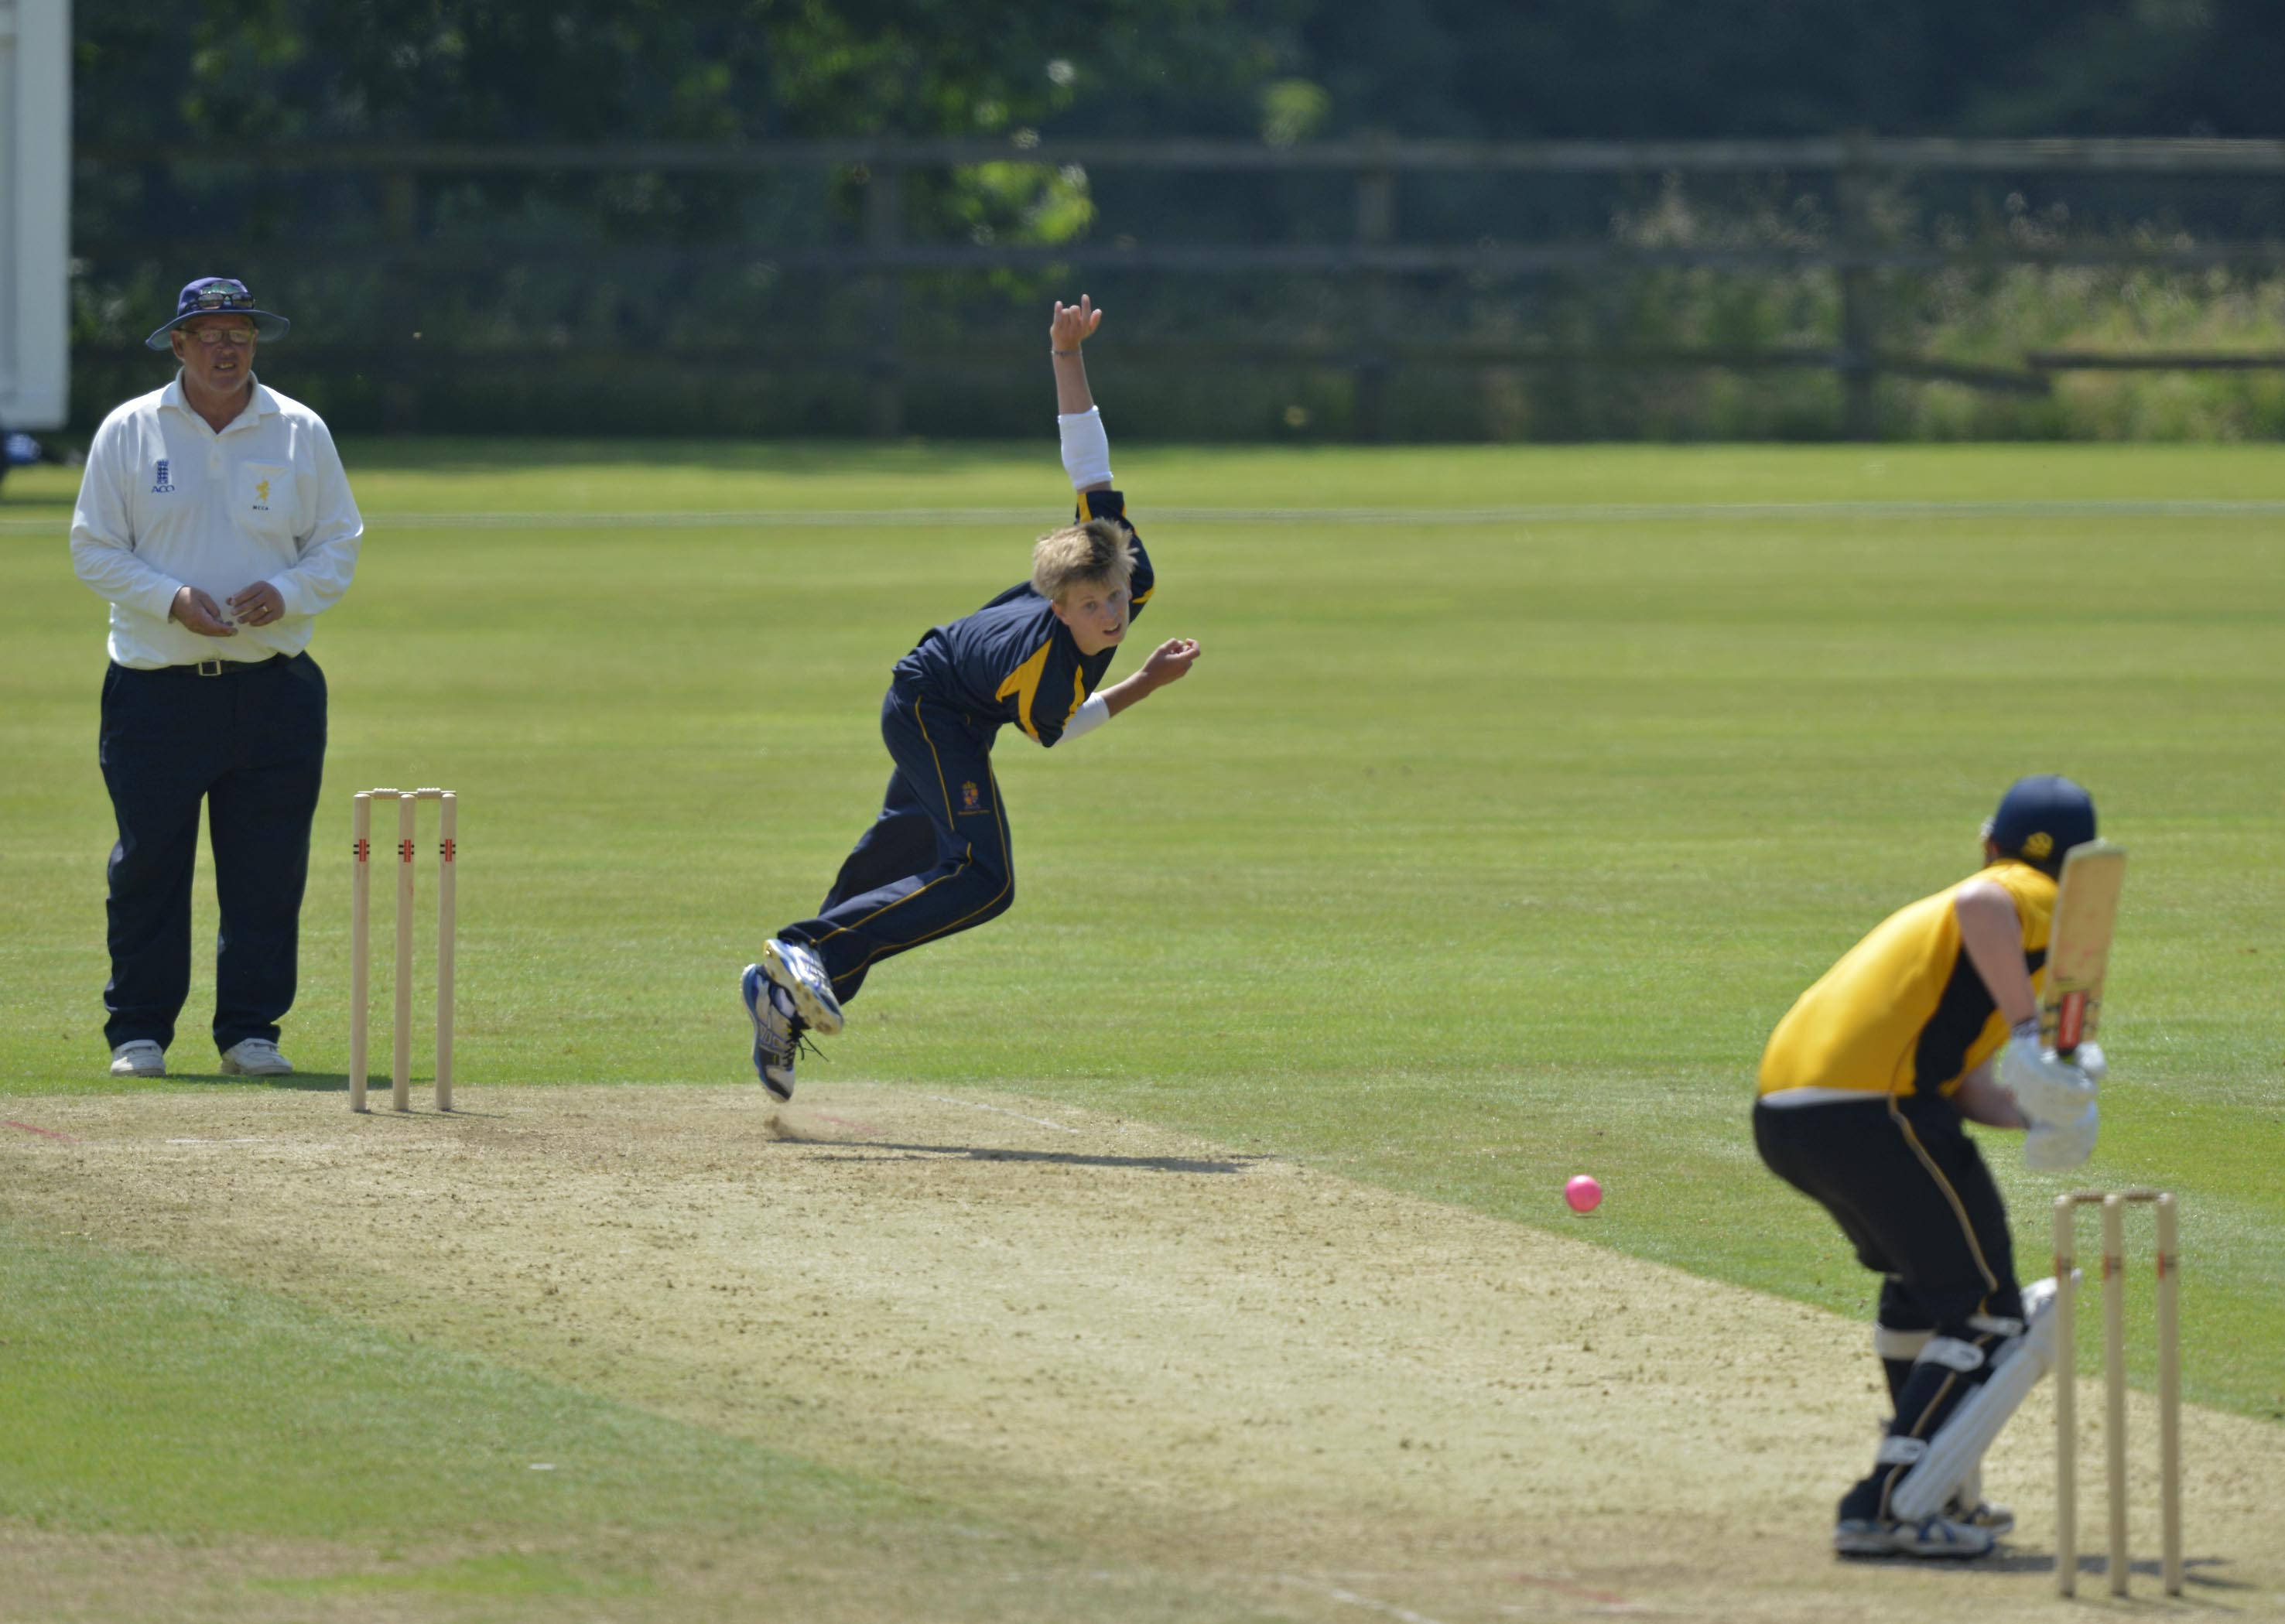
Will Cook (Shrewsbury) bowling in the semi-final Bolton v Shrewsbury

Slide 11
The second semi-final
Bede’s in dark blue
Bolton in blue with red flash

Slide 12
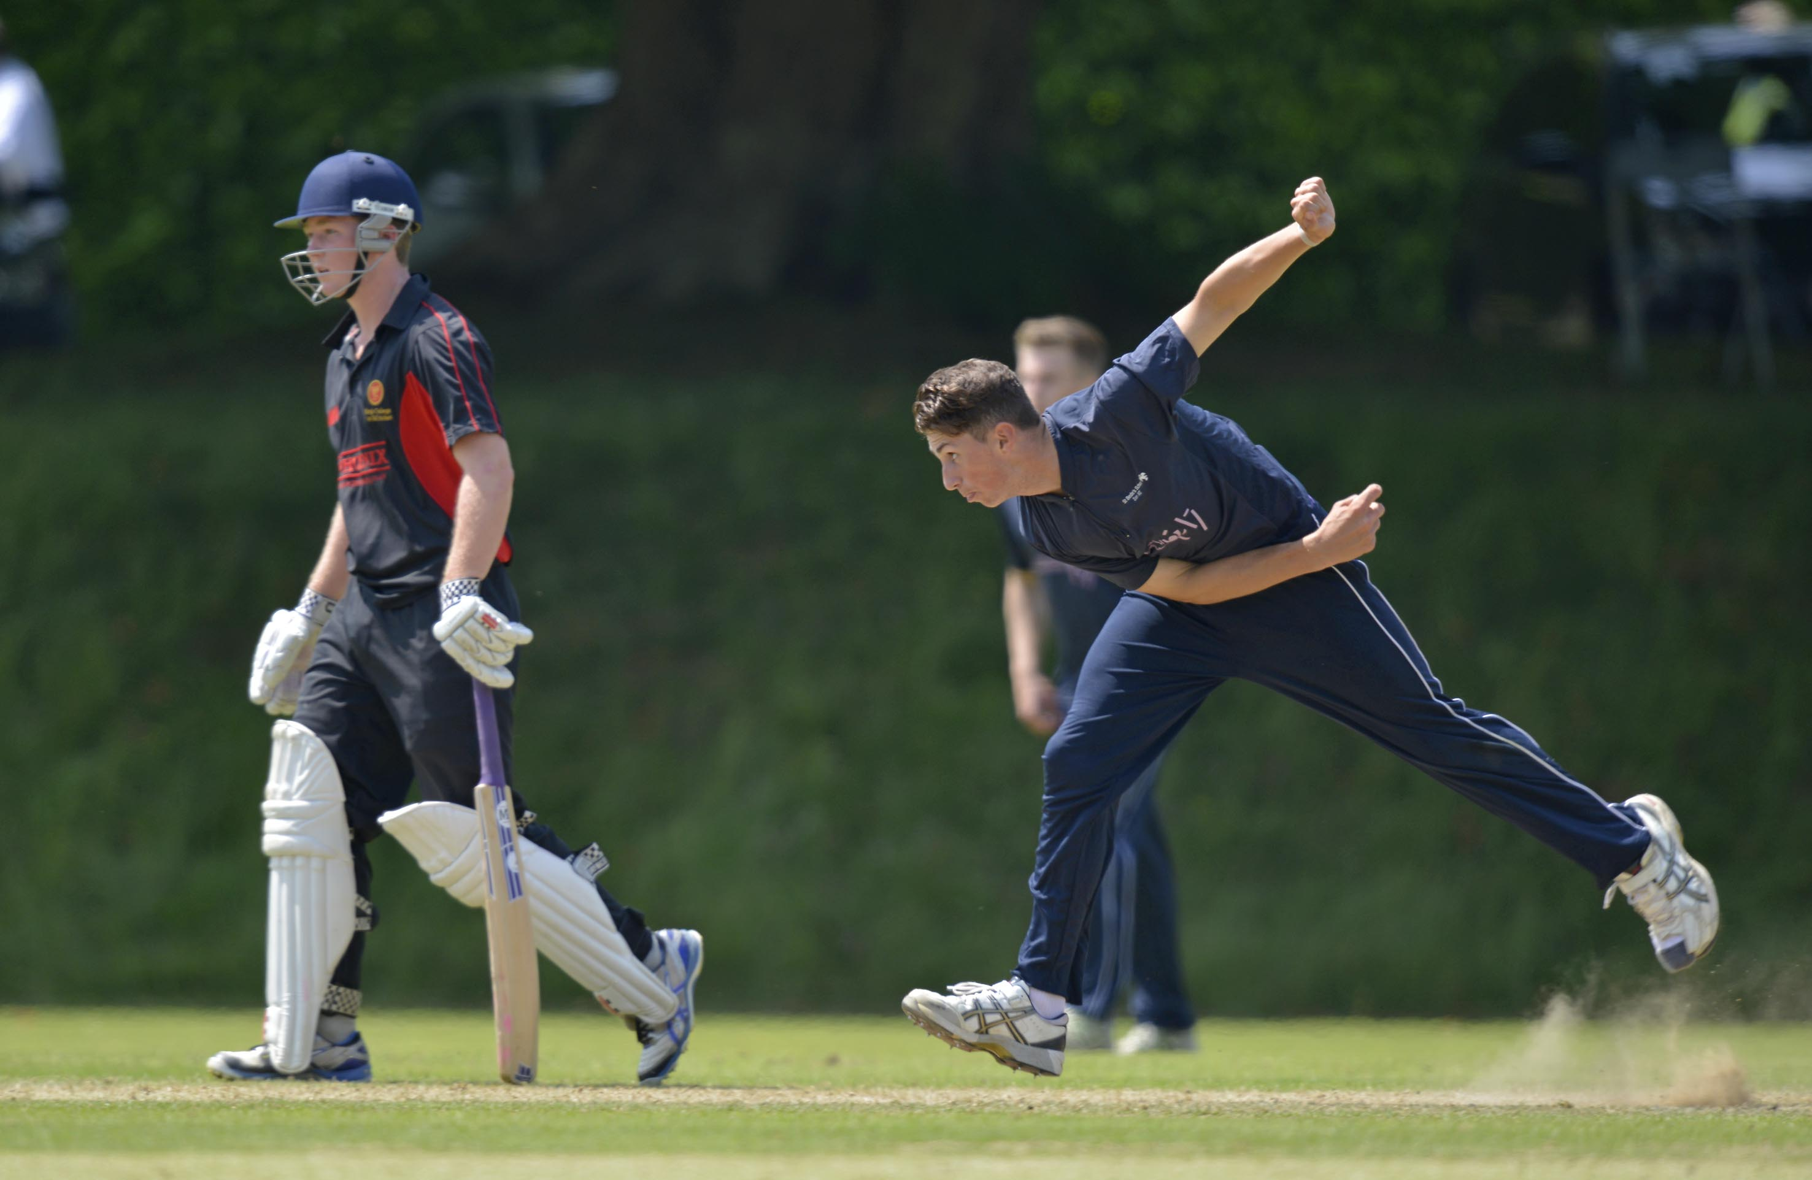
Fynn Hudson-Prentice (Bede's) bowling in the semi-final Bede's v King’s, Taunton

Slide 13
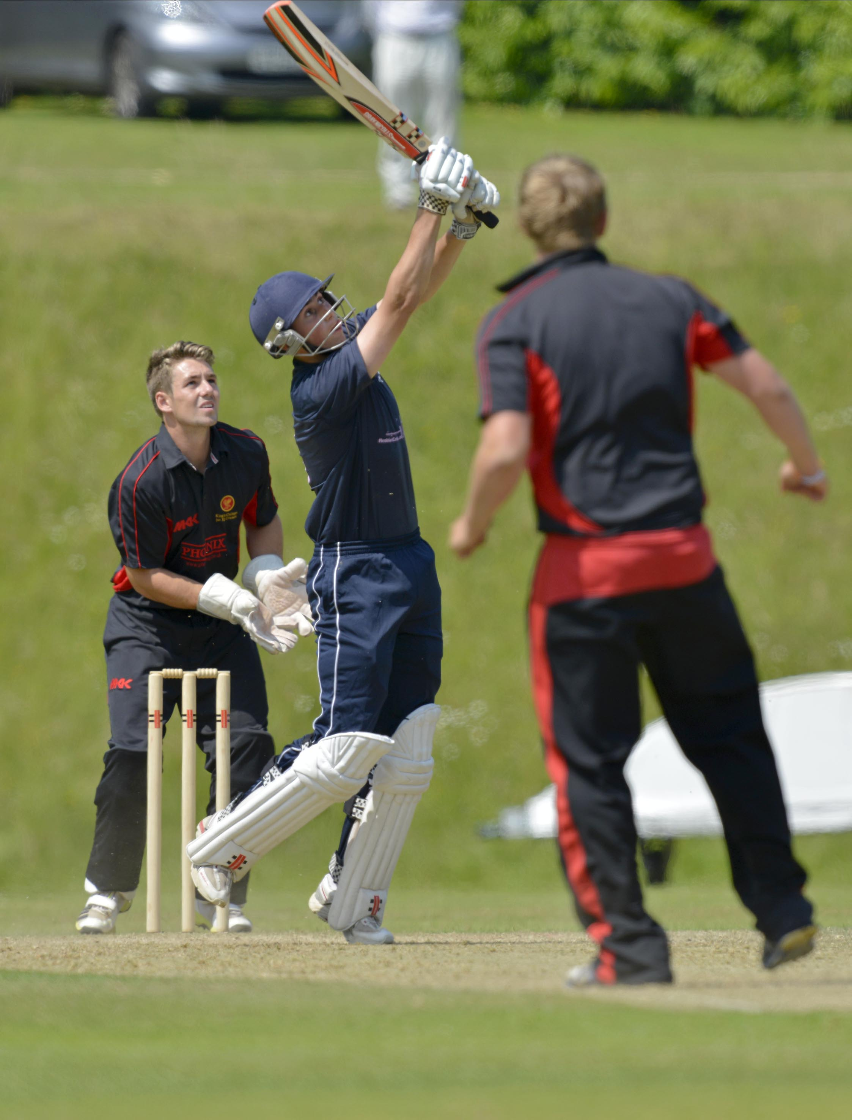
Fynn Hudson-Prentice (Bede's) who made 45 hits a boundary, Rhys Davies is the wicket-keeper; semi-final Bede's v King’s, Taunton

Slide 14
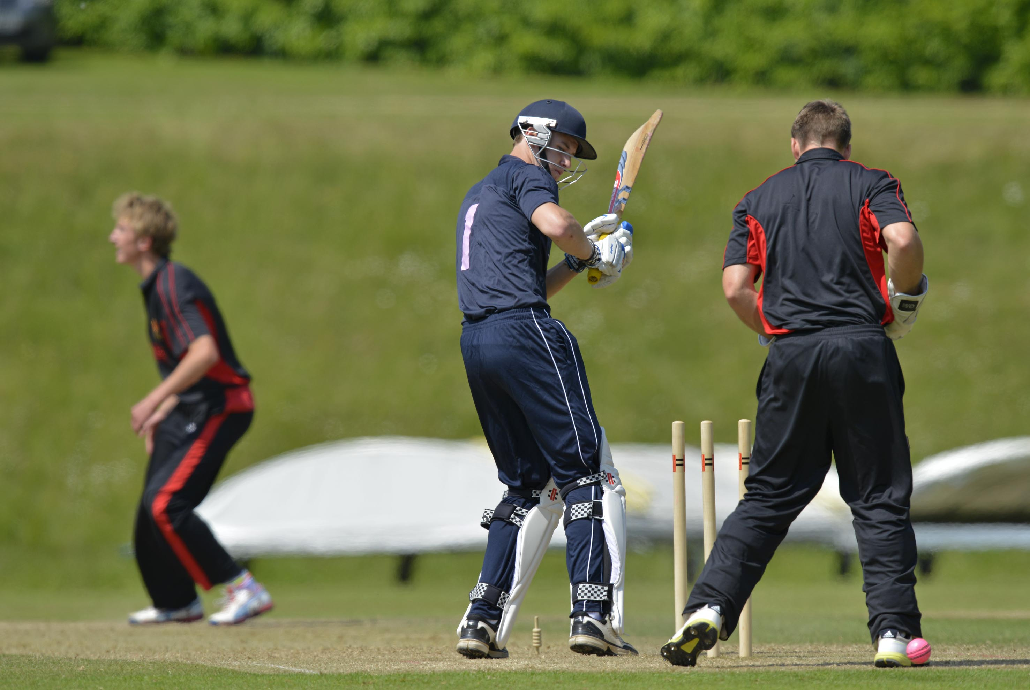
Daniel Wells (Bede's) is bowled by Neil Brand for 17 in the semi-final Bede's v King’s, Taunton

Slide 15
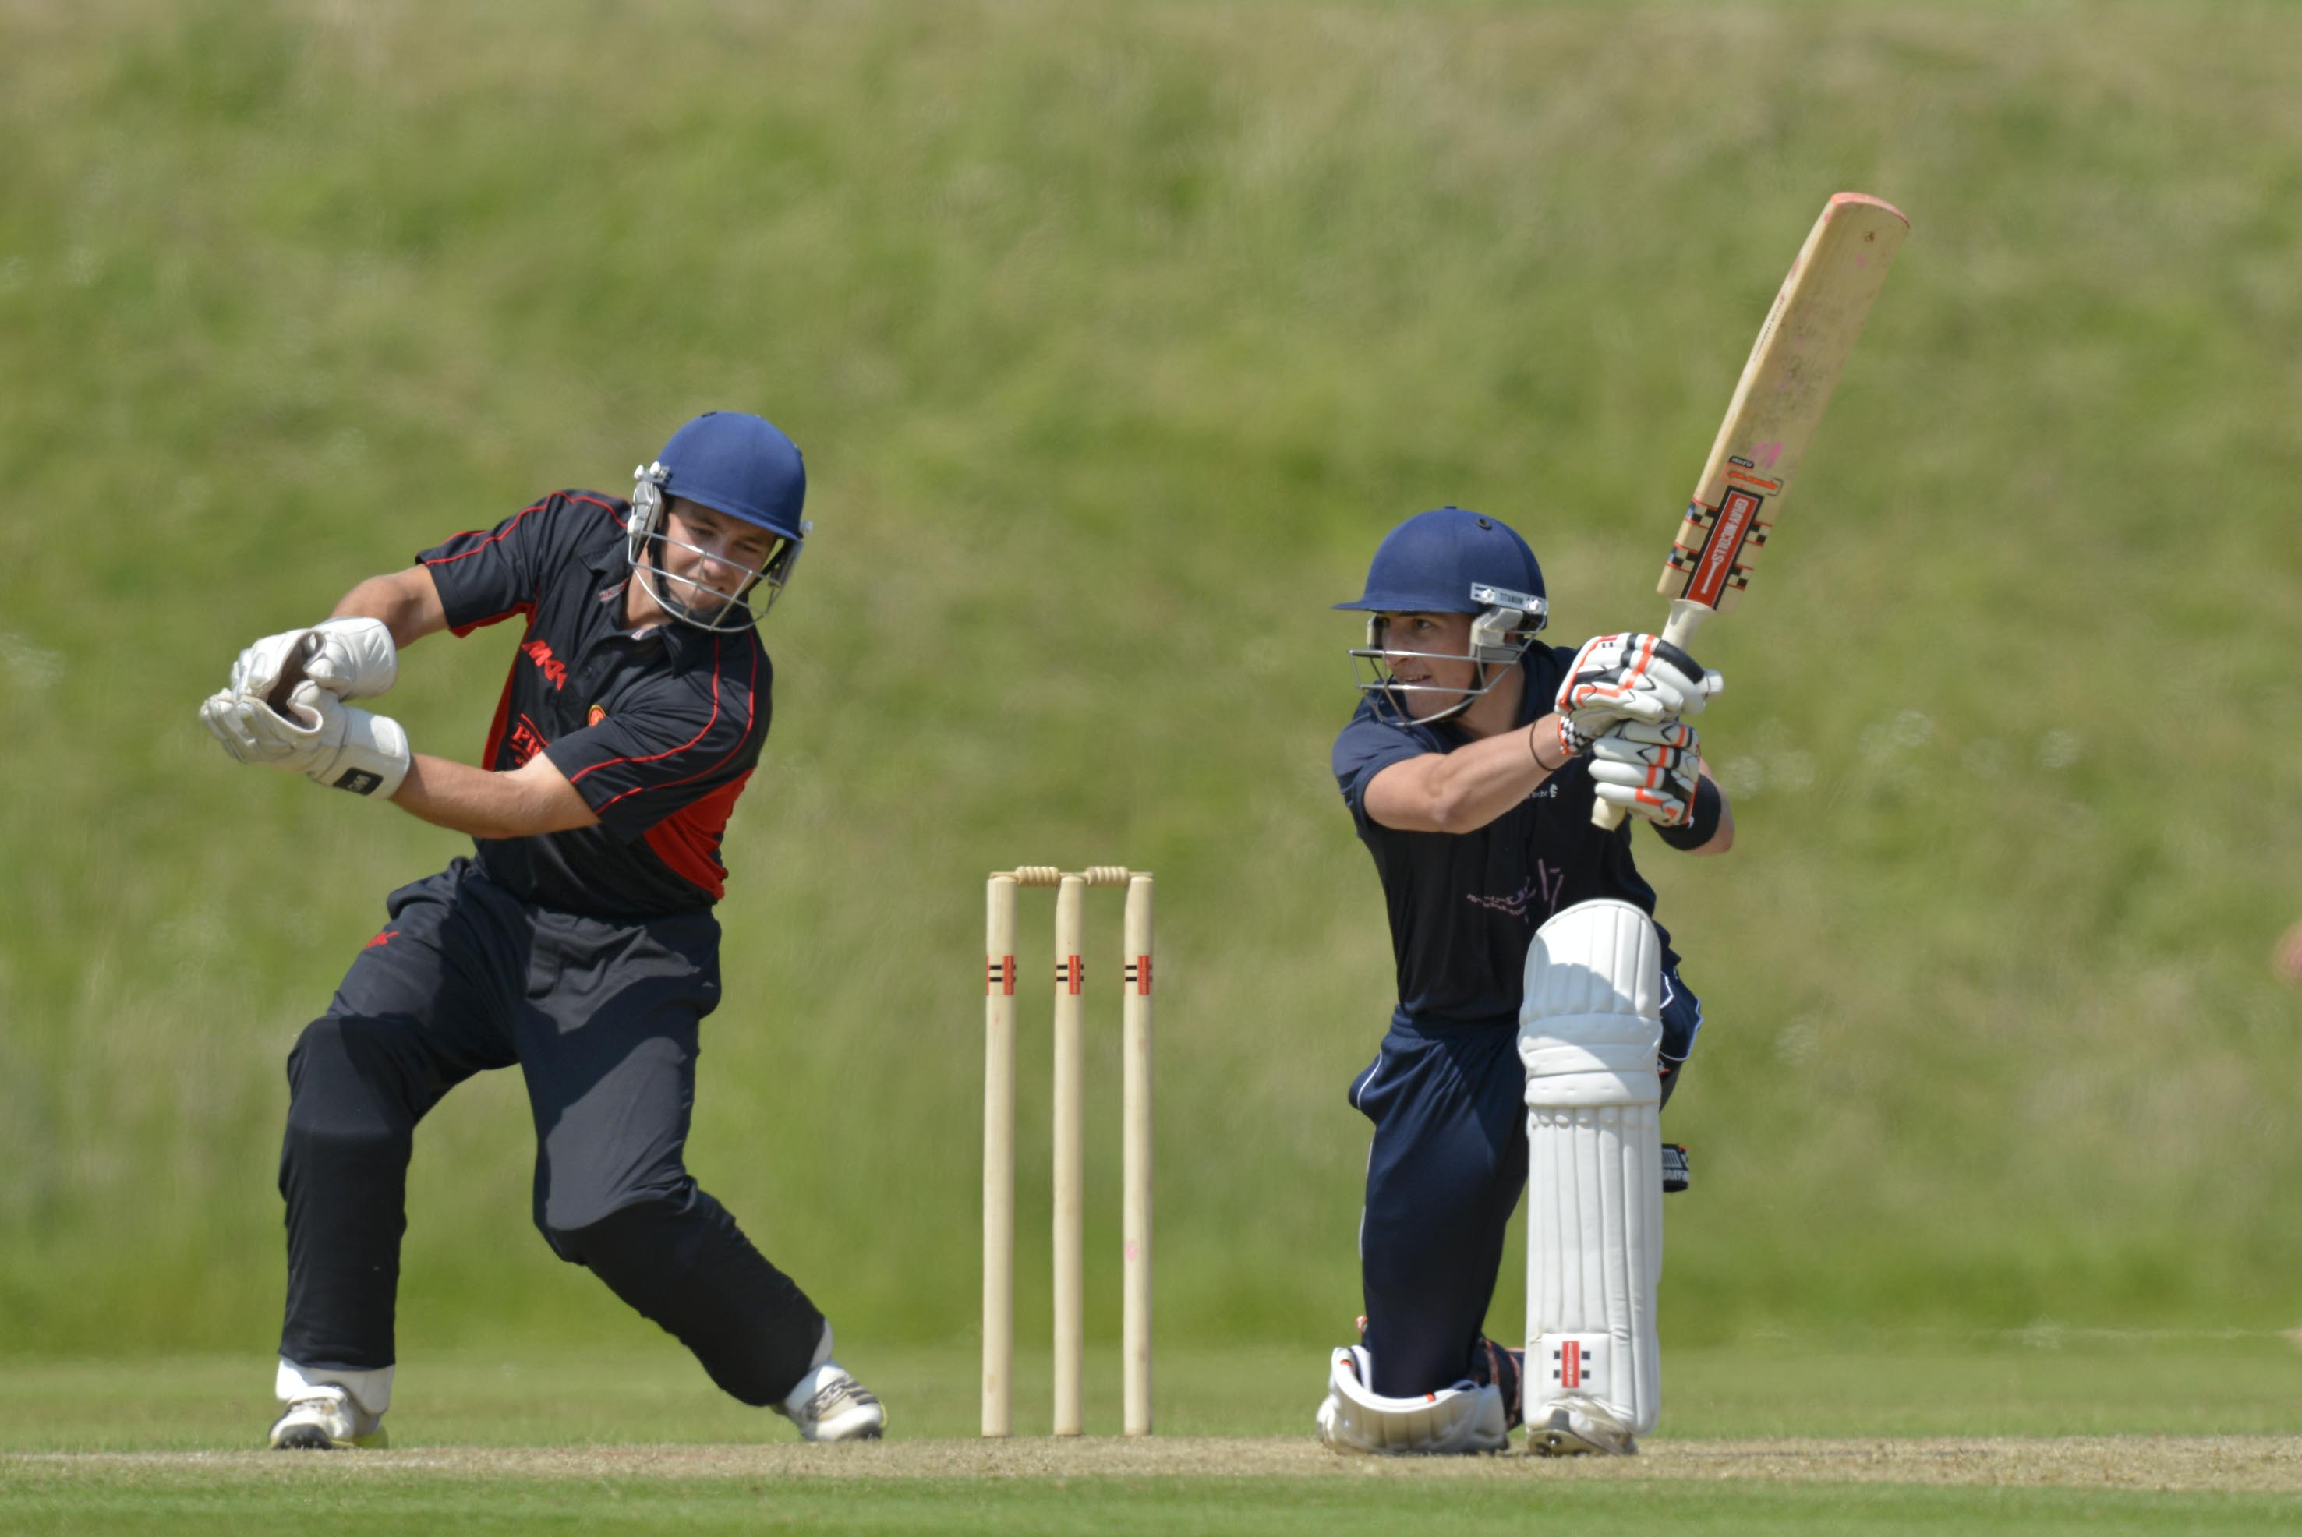
Callum Jackson (Bede's) drives in the semi-final Bede's v King’s, Taunton

Slide 16
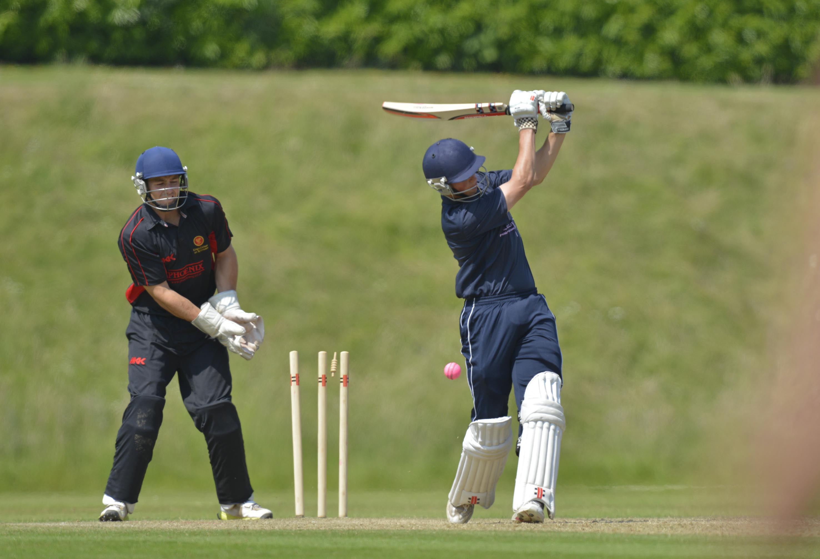
Fynn Hudson-Prentice (Bede's) bowled by Lawrence May for 45’; semi-final Bede’s v King’s, Taunton

Slide 17
The final
Shrewsbury in yellow
Bede’s in dark blue

Slide 18
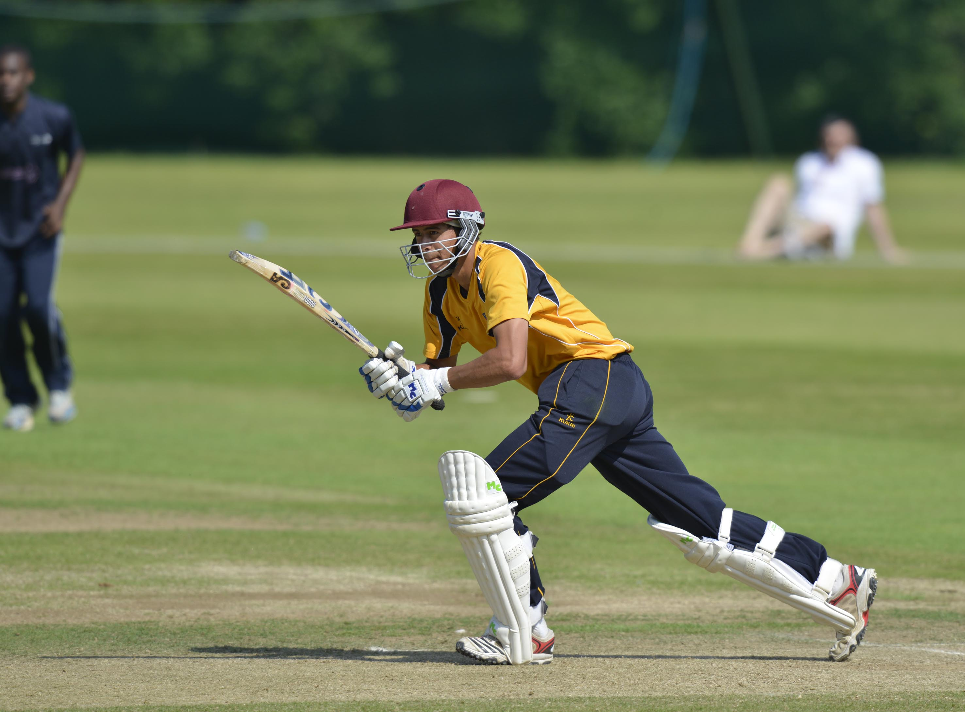
Joe Carrasco (Shrewsbury) who made 55 batting in the Final - Bede's v Shrewsbury

Slide 19
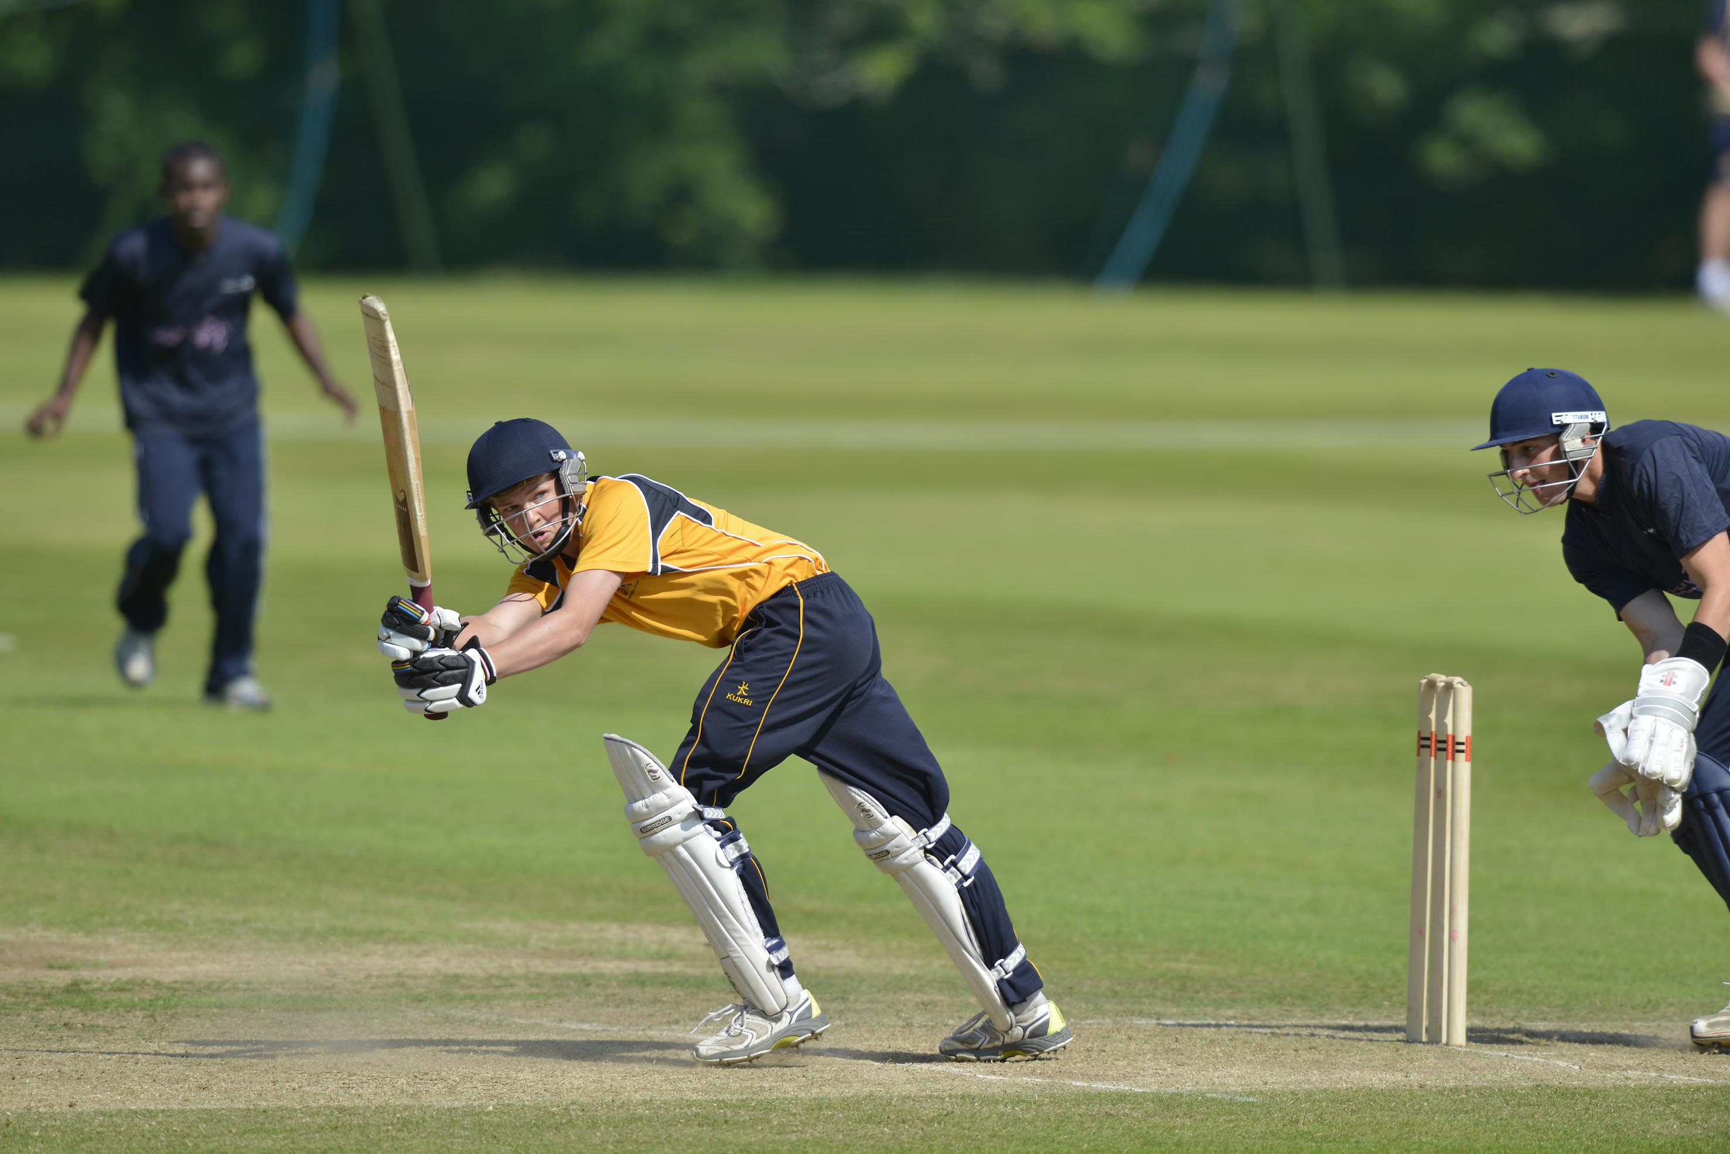
George Lewis (Shrewsbury) batting in the Final - Bede's v Shrewsbury

Slide 20
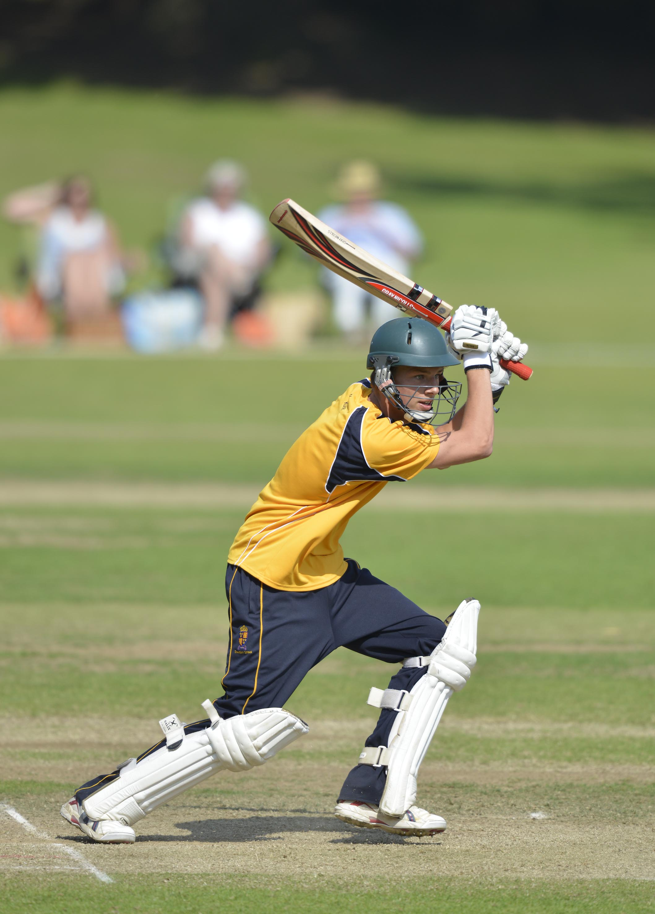
Charlie White (Shrewsbury) batting during his 11, Final - Bede's v Shrewsbury

Slide 21
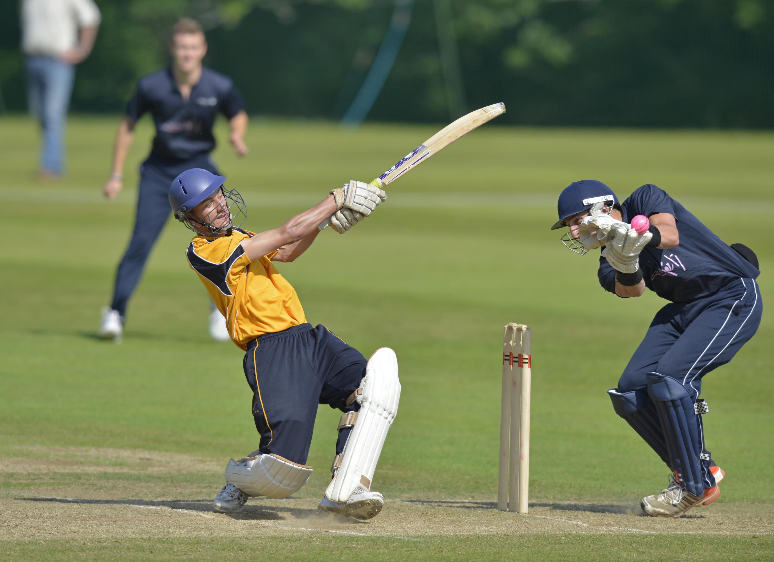
Fred Earlam misses with a big swing, Callum Jackson fumbles; Bede's v Shrewsbury

Slide 22
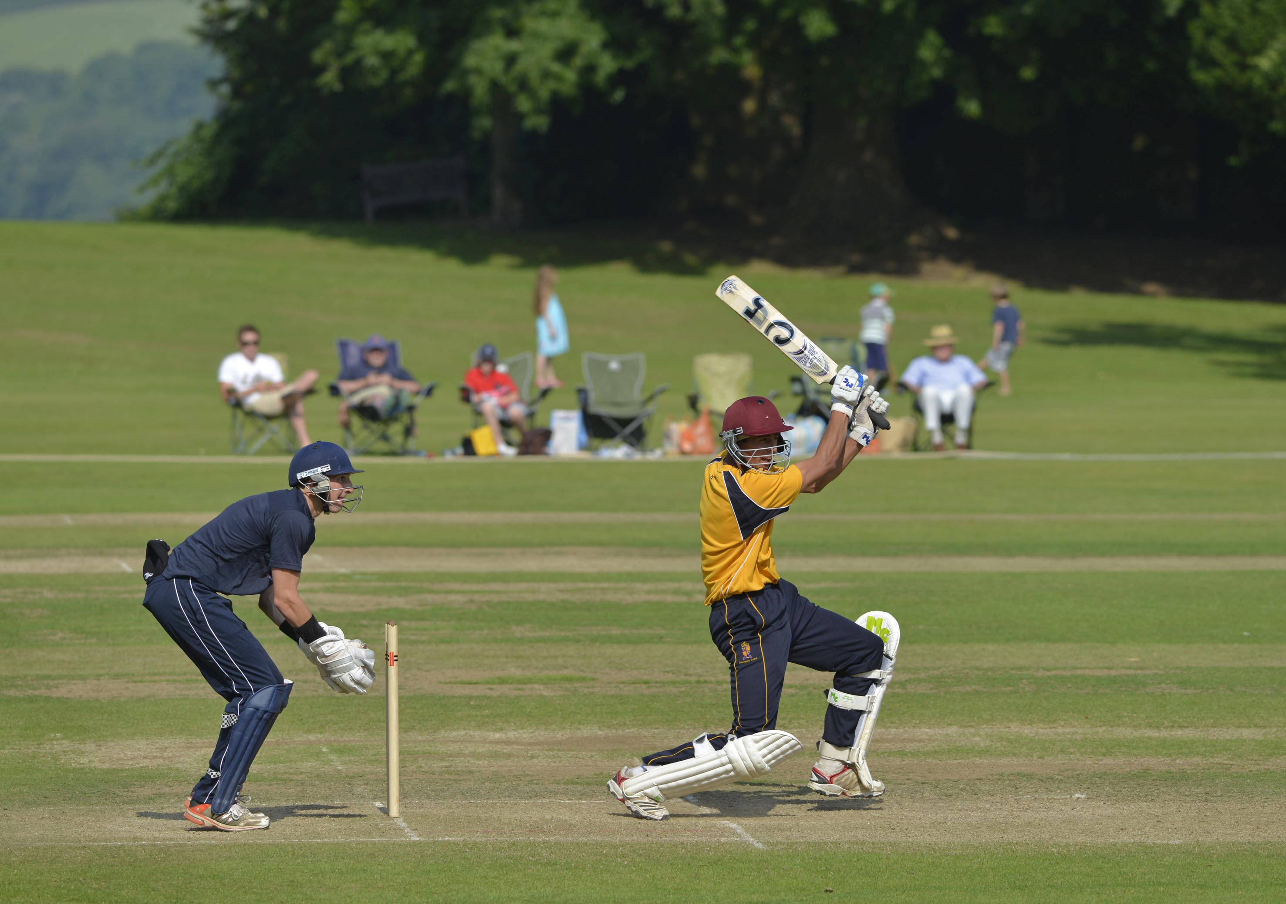
Joe Carrasco (Shrewsbury) batting; Callum Jackson, the Bede's captain is the wicket-keeper; Bede’s v Shrewsbury

Slide 23
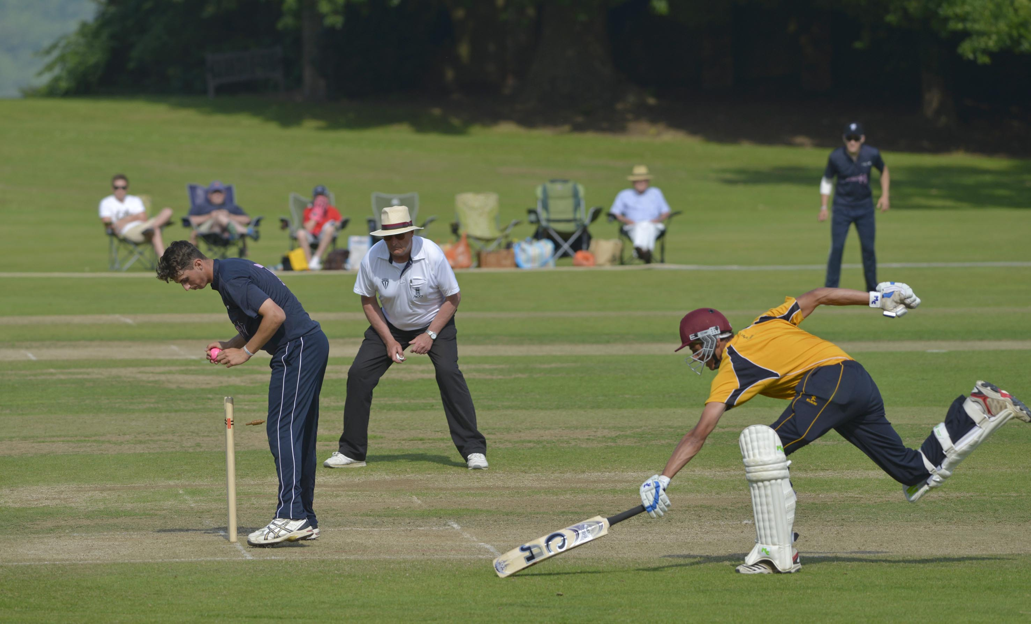
Joe Carrasco (Shrewsbury) run out 55; Final - Shrewsbury v Bede’s

Slide 24
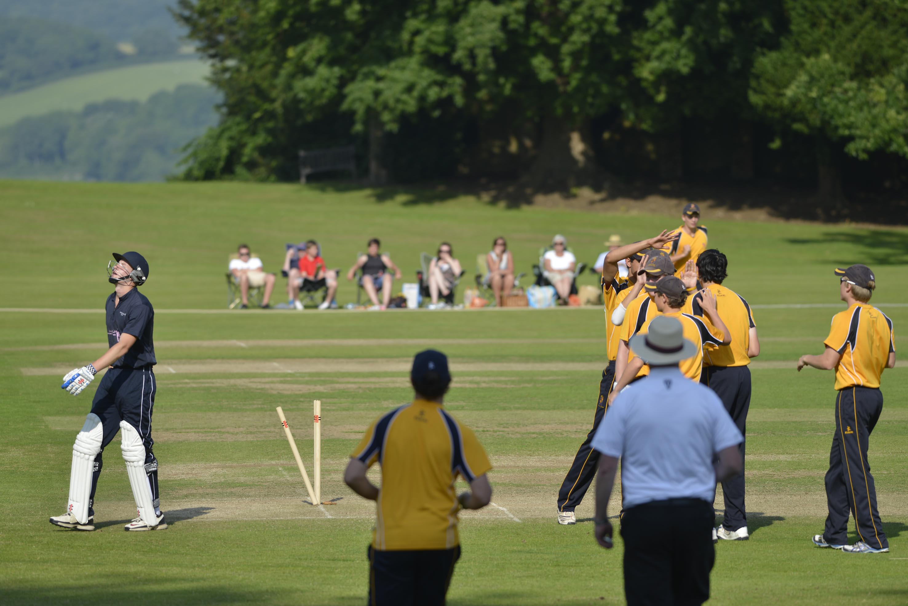
Daniel Wells (Bede's) bowled by George Panayi for 19; Final - Bede's v Shrewsbury

Slide 25
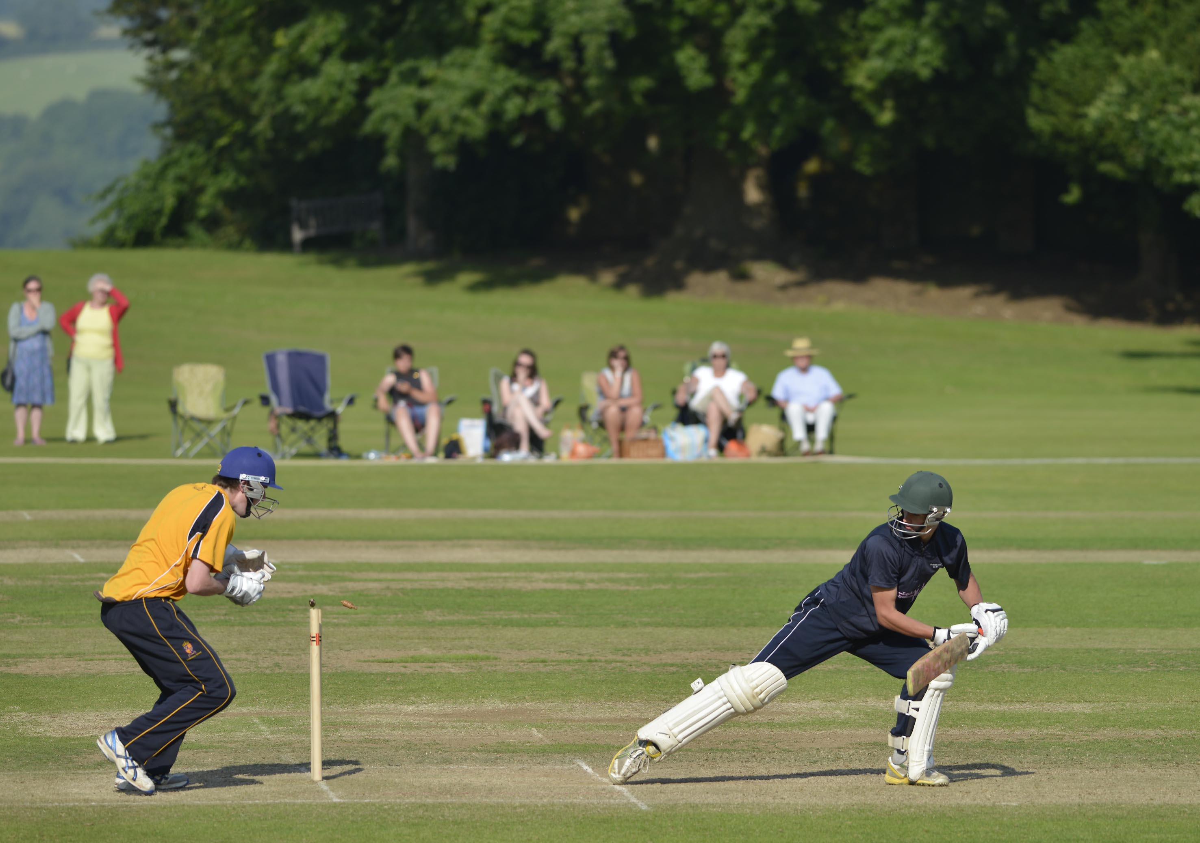
Callum Guest is stumped by Bertie Milligan-Manby off Henry Blofield for 2, Final – Bede’s v Shrewsbury

Slide 26
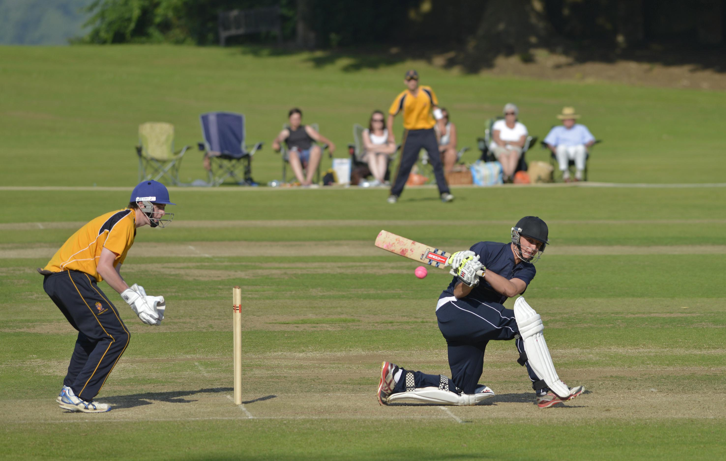
Elliot Hooper (Bede’s) hits to leg; Bertie Milligan-Manby is the wicket-keeper

Slide 27
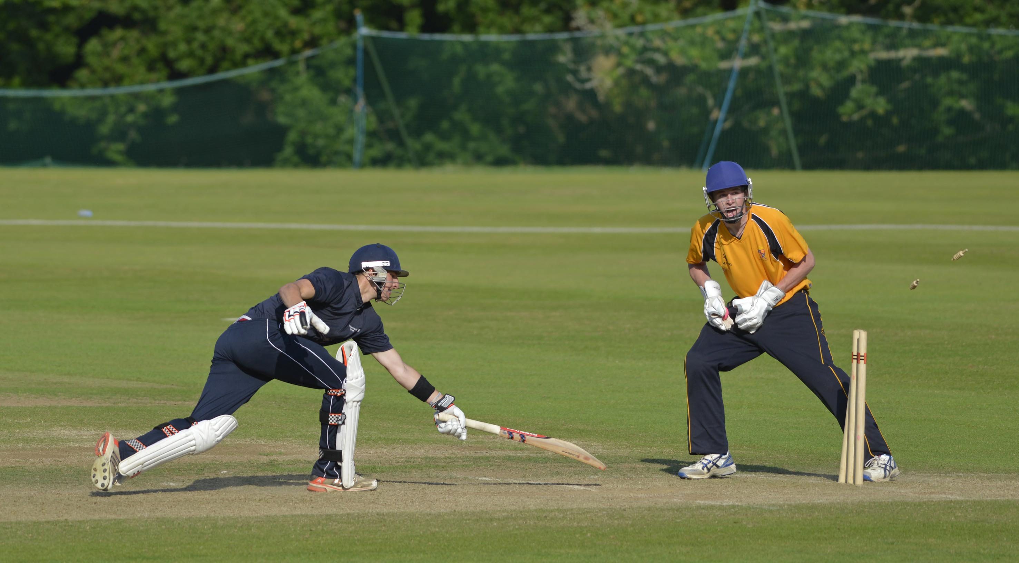
(Bede’s) stumped by Bertie Milligan-Manby, bowled Matt Gregson for 19; Final - Shrewsbury v Bede’s

Slide 28
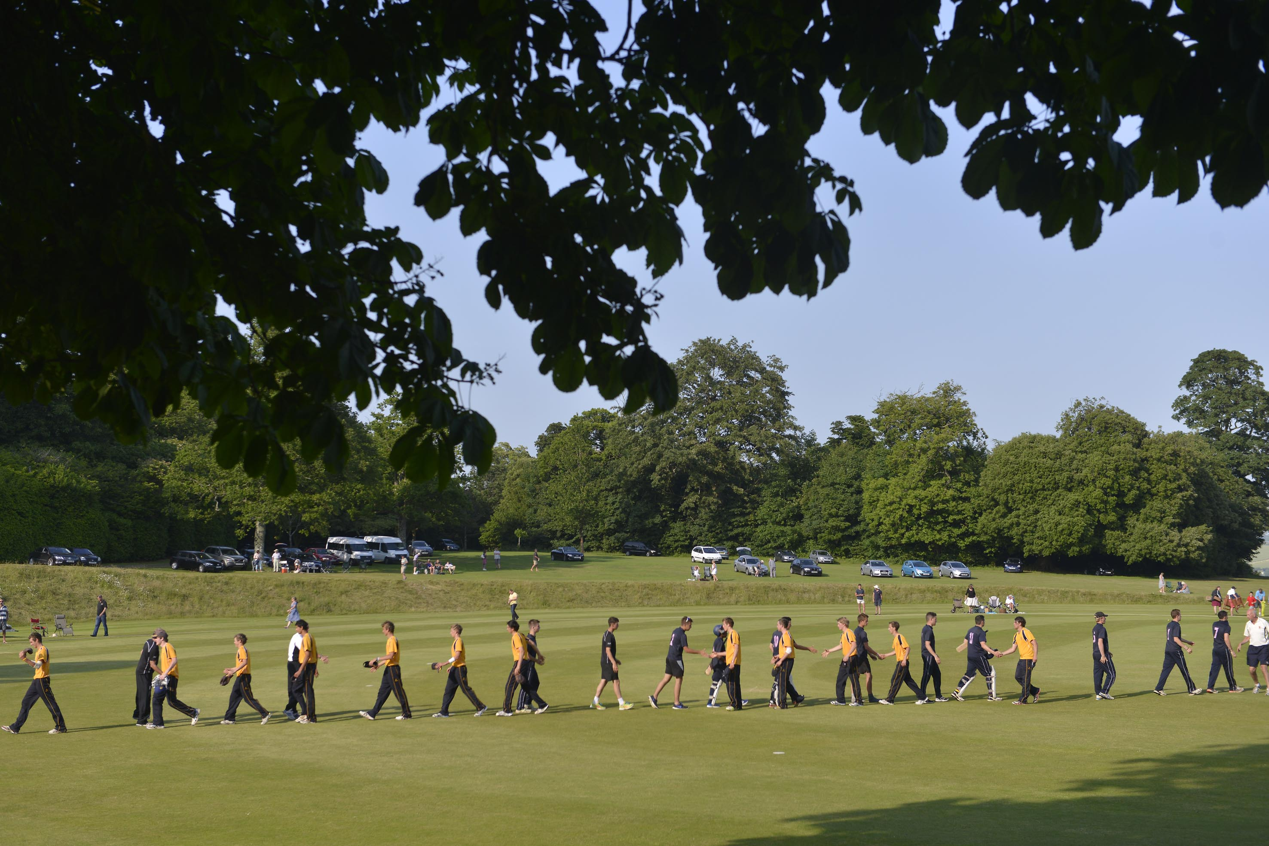
The two finalist teams at the conclusion of the match, won by Shrewsbury; Final - Bede's v Shrewsbury

Slide 29
The presentation by James Kirtley
Sussex and England
2013 winners
Shrewsbury

Slide 30
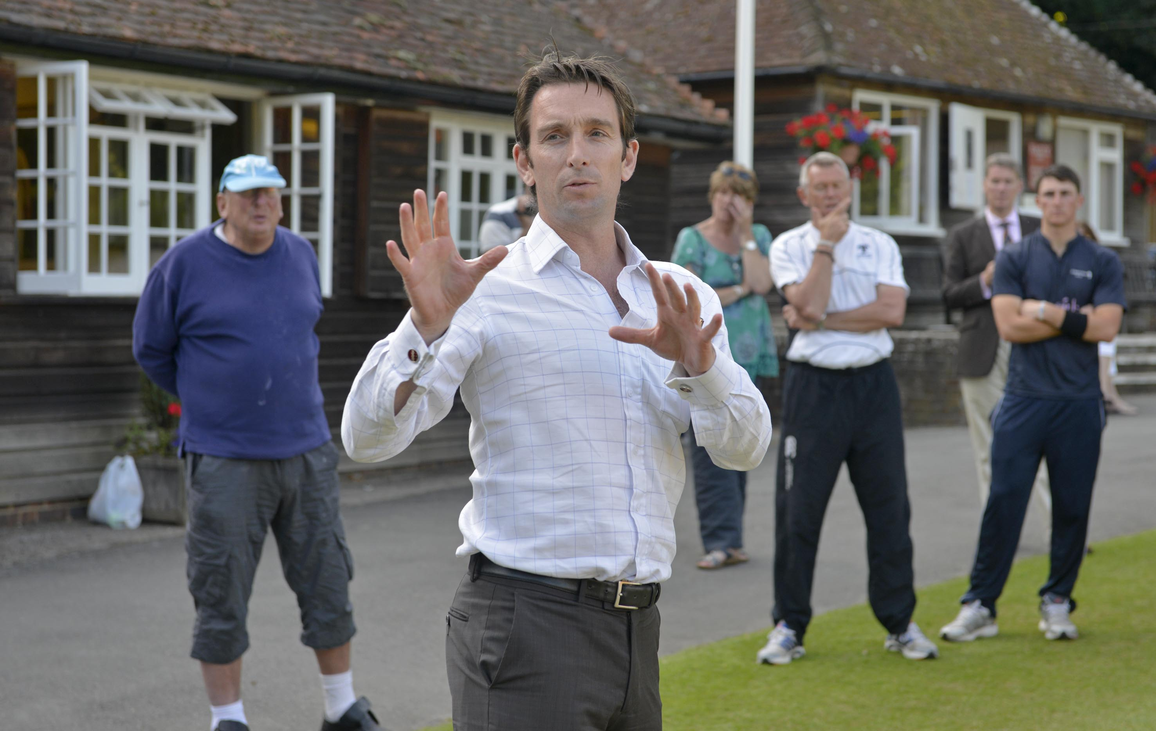
James Kirtley (Sussex and England) at the presentation, Final - Bede's v Shrewsbury

Slide 31
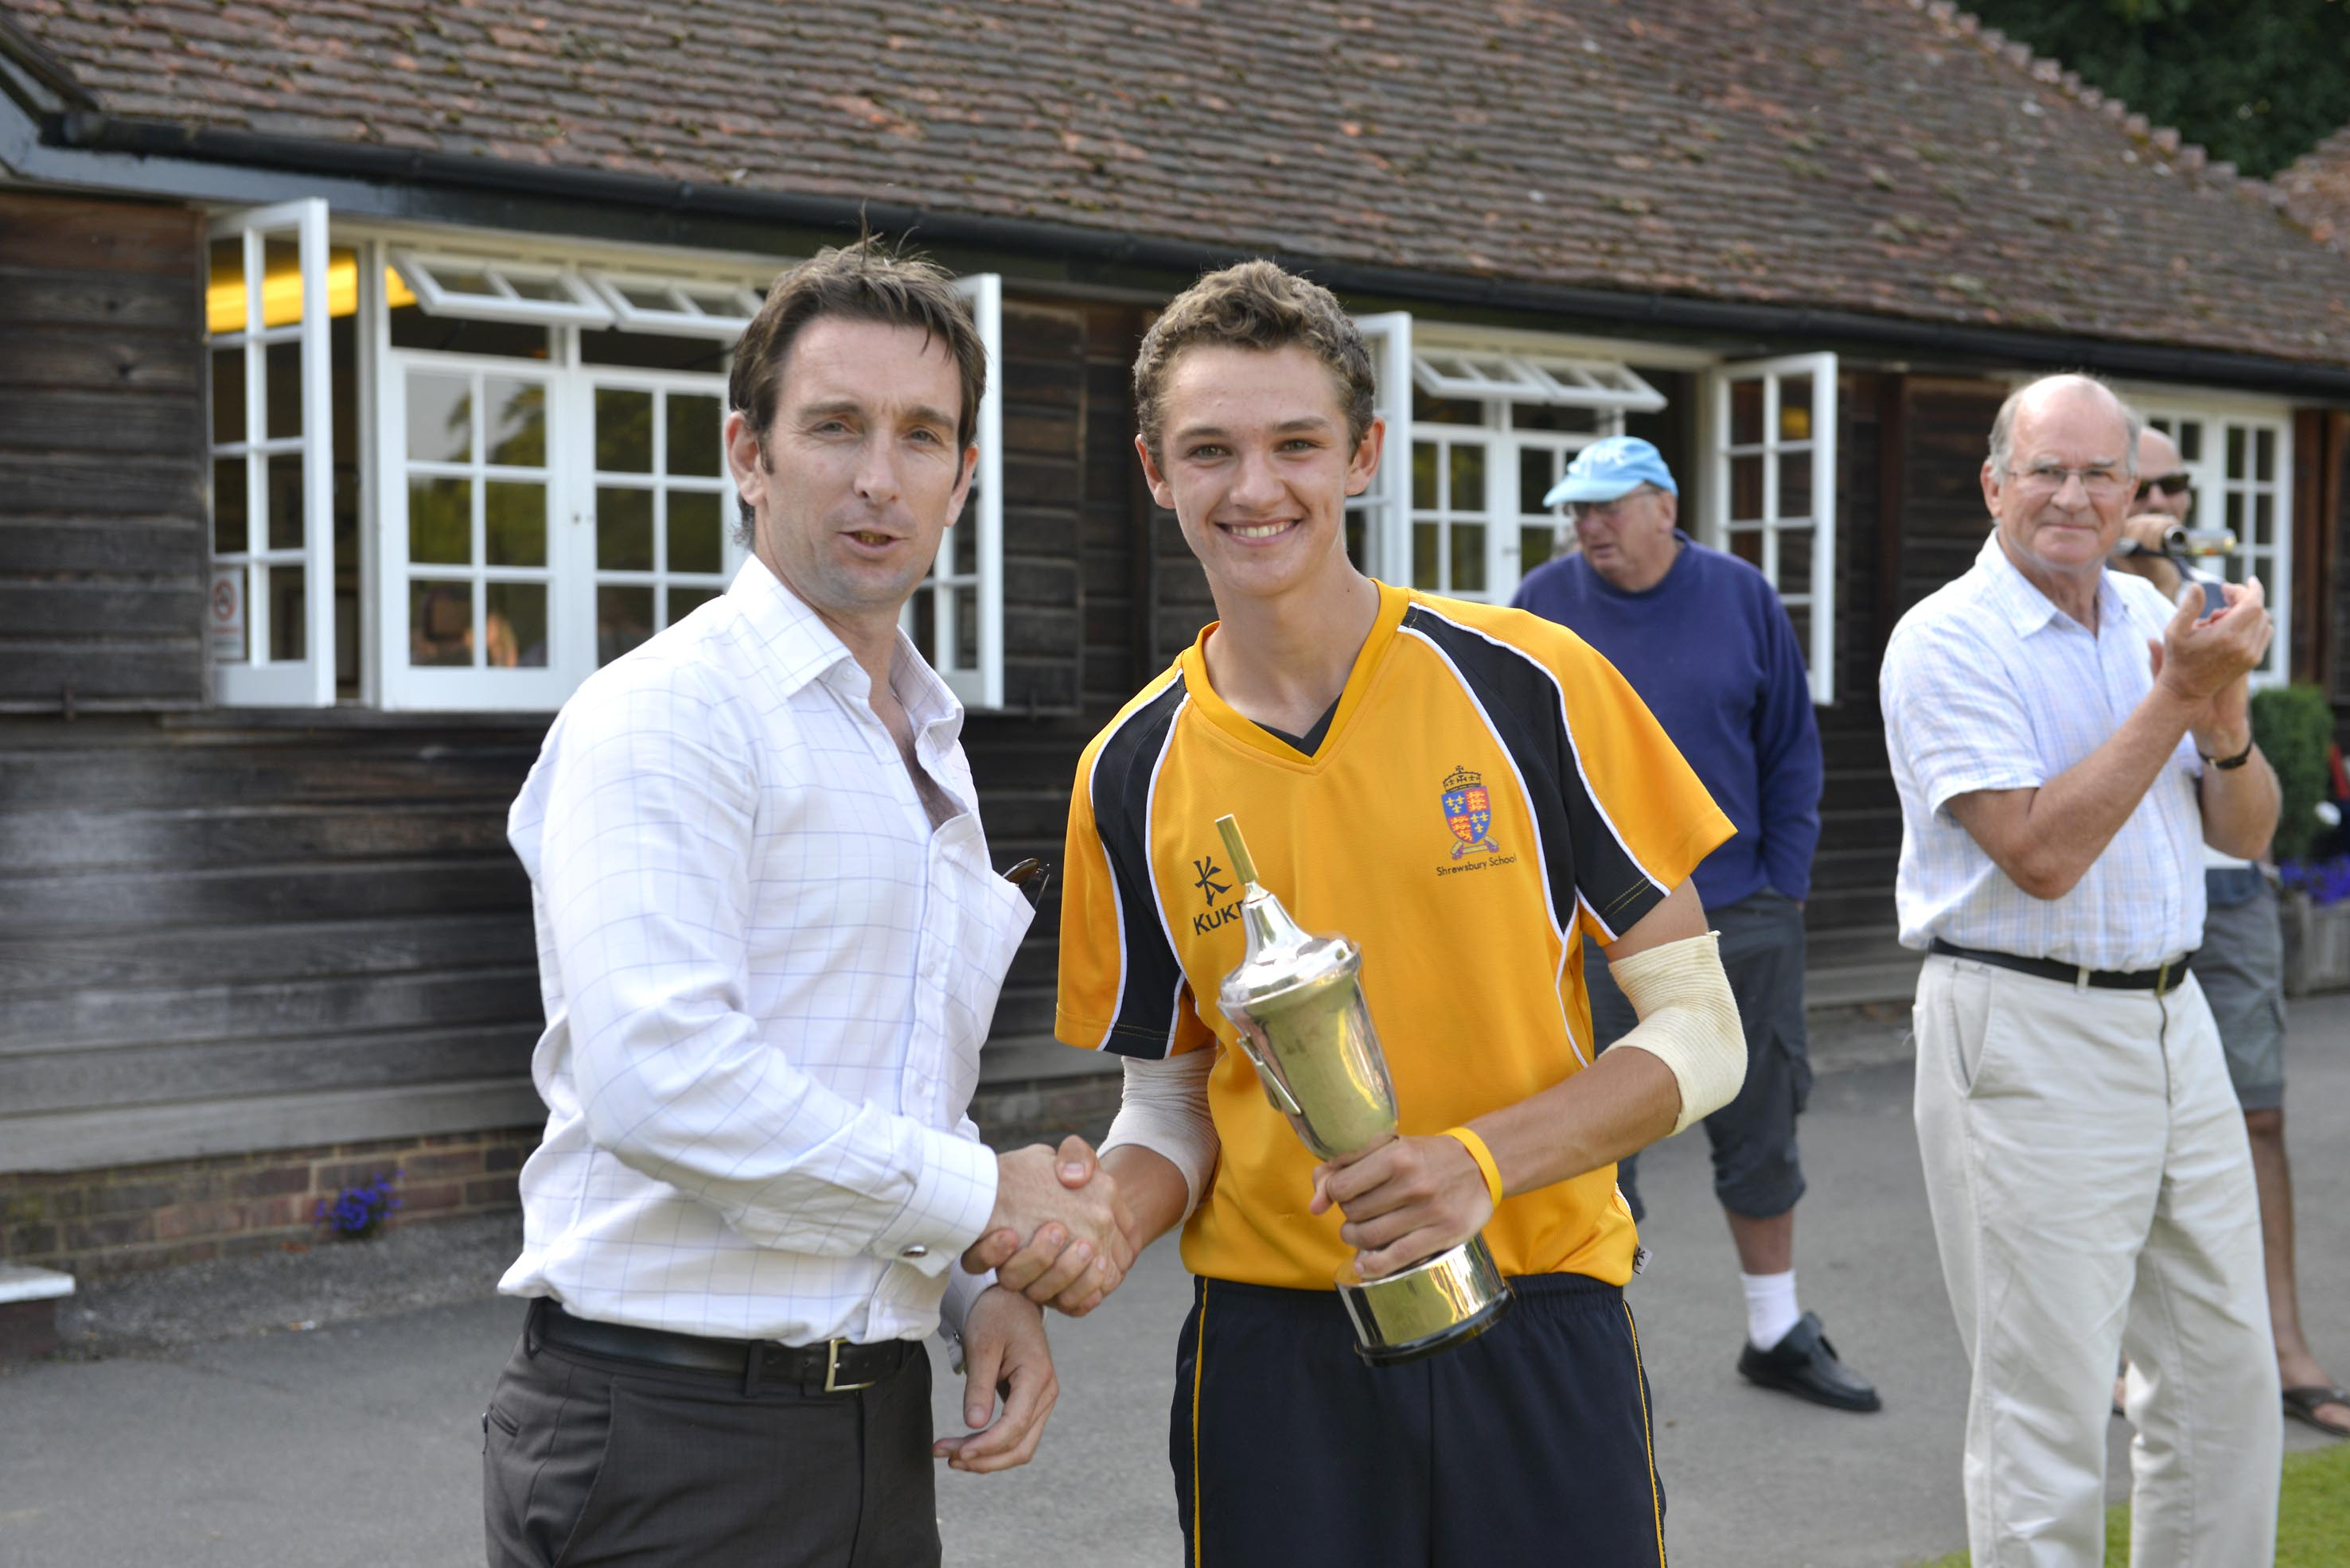
James Kirtley (Sussex and England) presents the trophy to Henry Blofield of Shrewsbur;, Final – Bede’s v Shrewsbury,

Slide 32
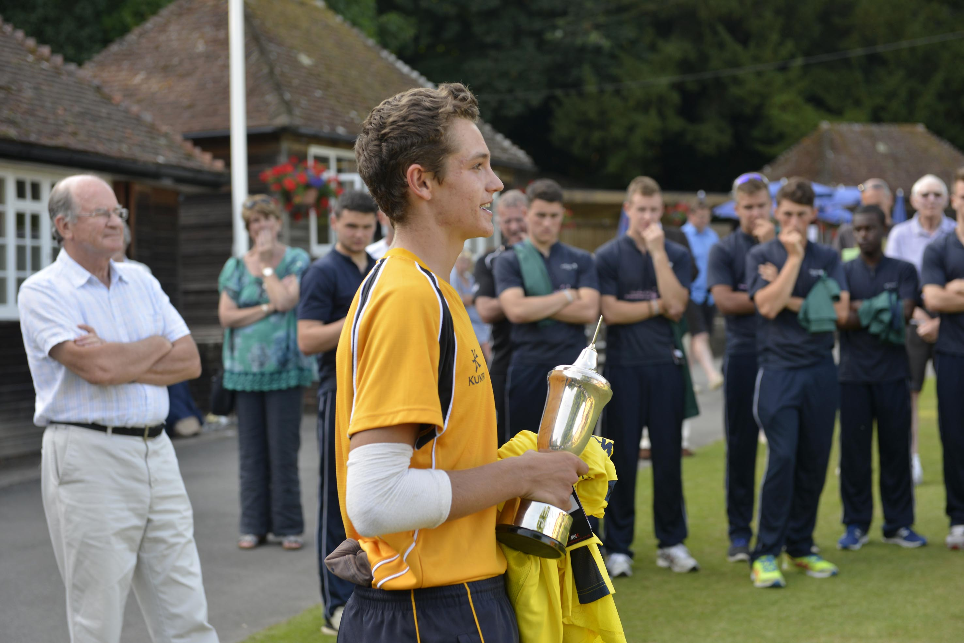
Henry Blofield (Shrewsbury) after accepting the Trophy as winning captain. Final - Bede's v Shrewsbury

Slide 33
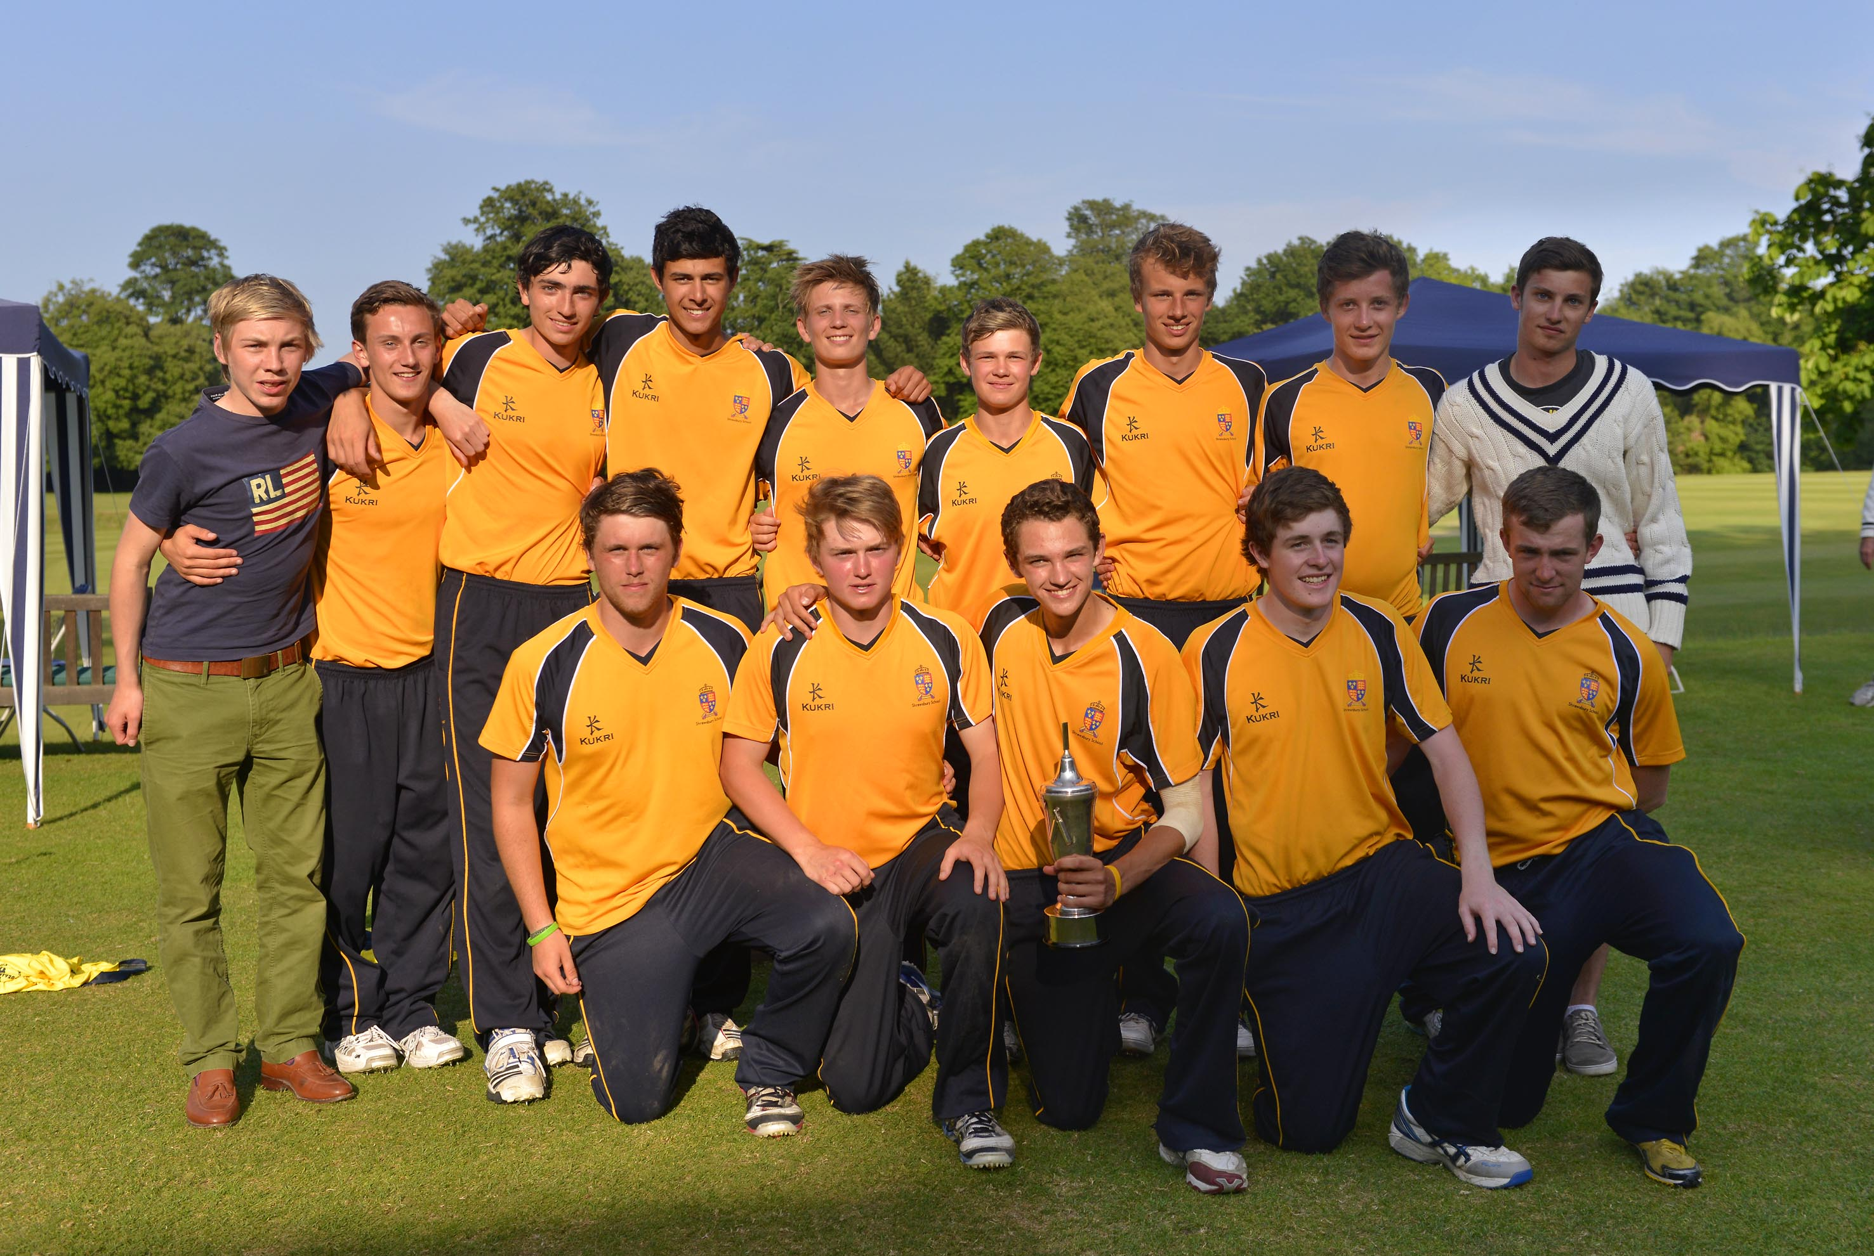
Shrewsbury, the winning team. Final – Bede’s v Shrewsbury

Slide 34
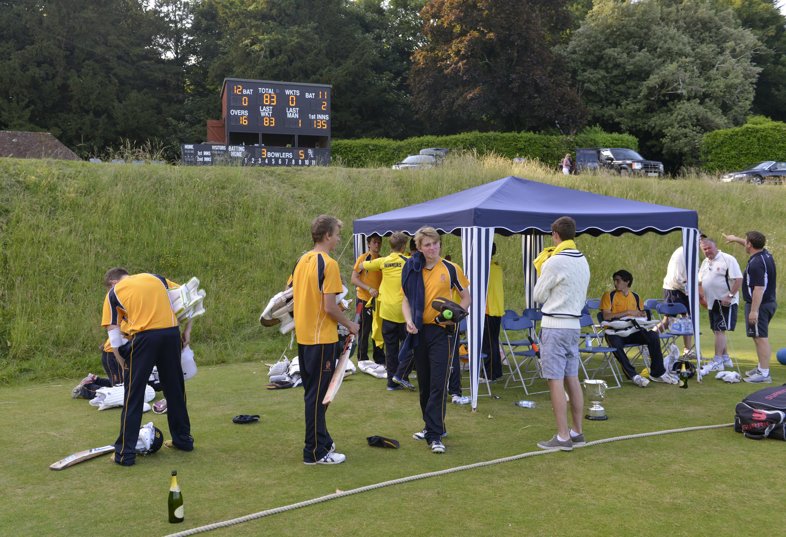
The winning Shrewsbury team pack up while the scoreboard tells the story. Final - Bede's v Shrewsbury

Slide 35
Photographs
by
Patrick Eagar
© No images may be reproduced without permission

Slide 36
National Schools Twenty20 competition
Finals day July 2013
Arundel Castle

